Slide 1
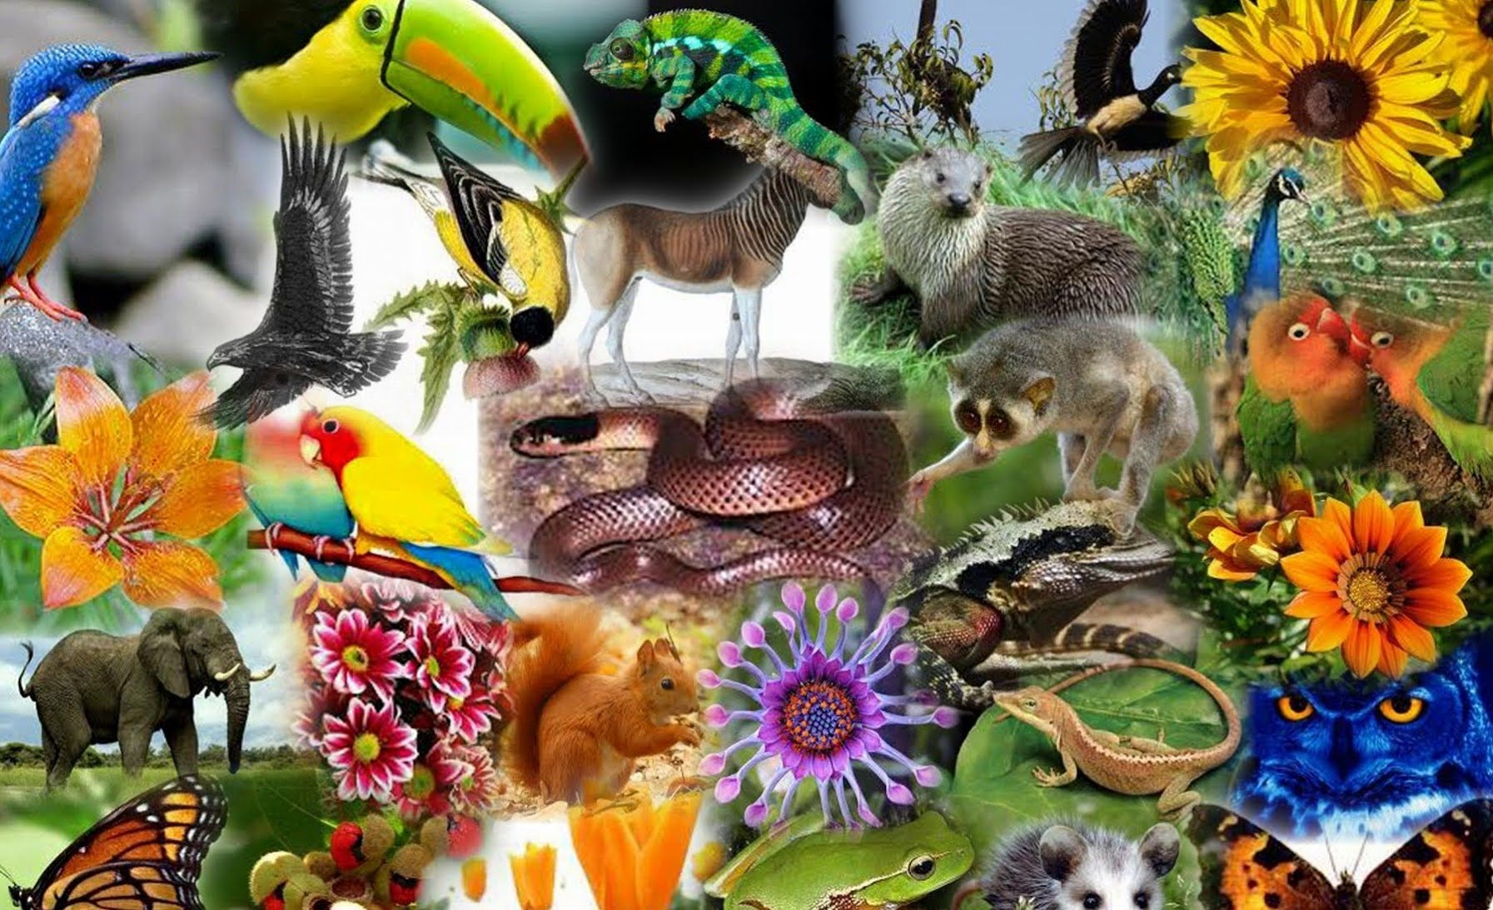
The variety of life in the world or a particular habitat.
Biodiversity

Slide 2
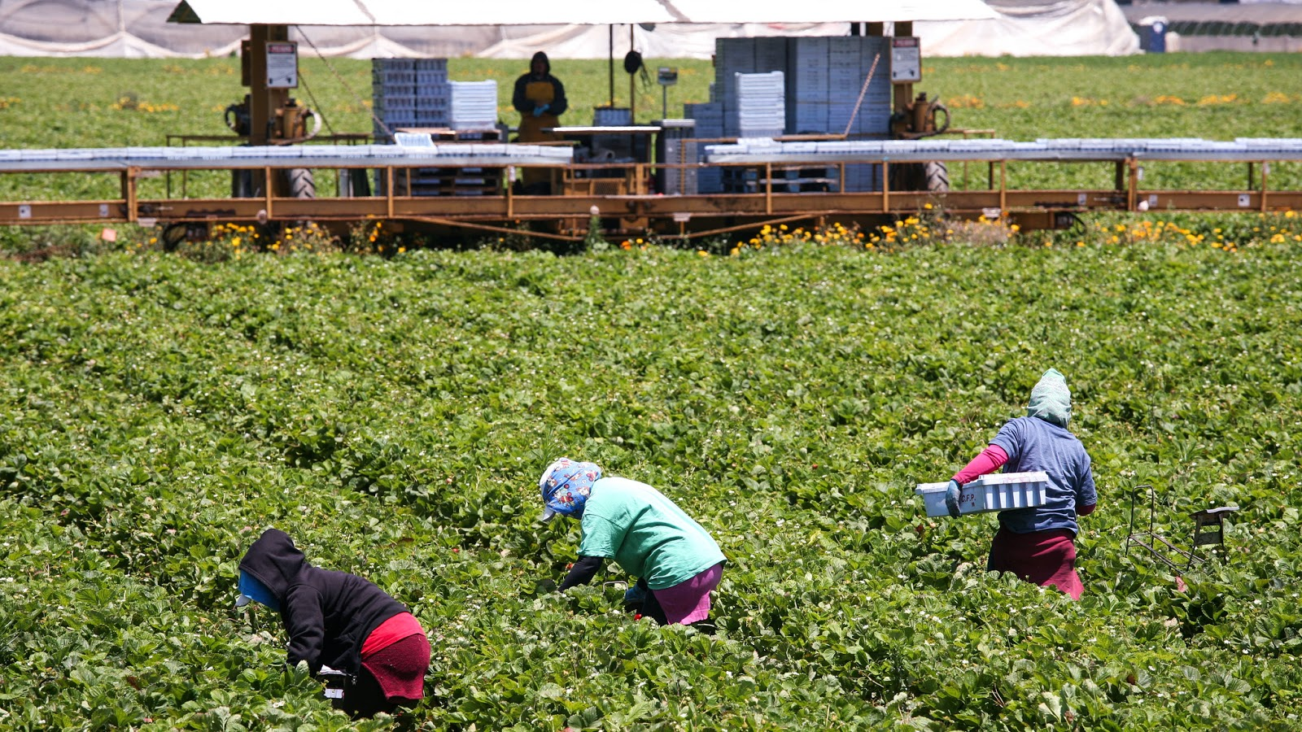
Farming to sell produce for a profit to retailers or food processing companies.
Commercial farming

Slide 3
Schemes under which a portion of a nation's foreign debt is forgiven in exchange for investments in environmental conservation measures.
Debt-for-nature swap/scheme

Slide 4
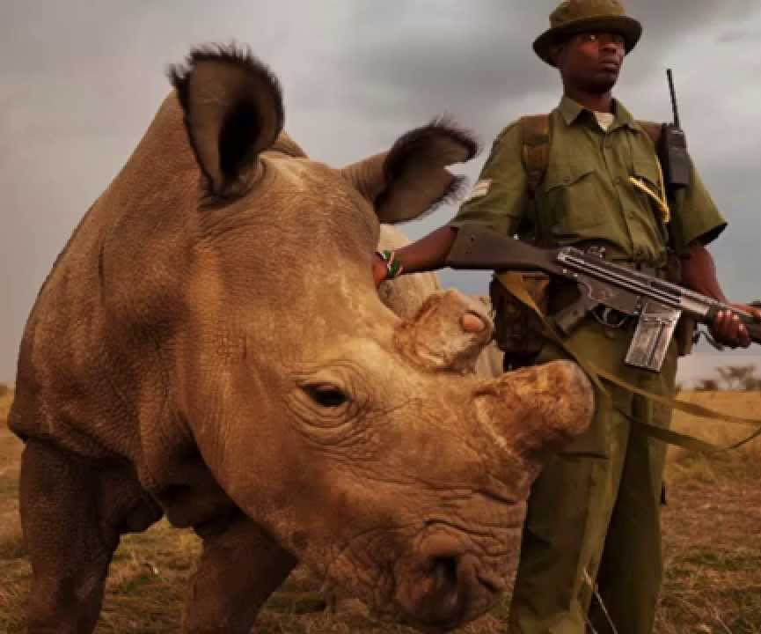
The management of nature with the aim of protecting species, their habitats and ecosystems from damage.
Conservation

Slide 5
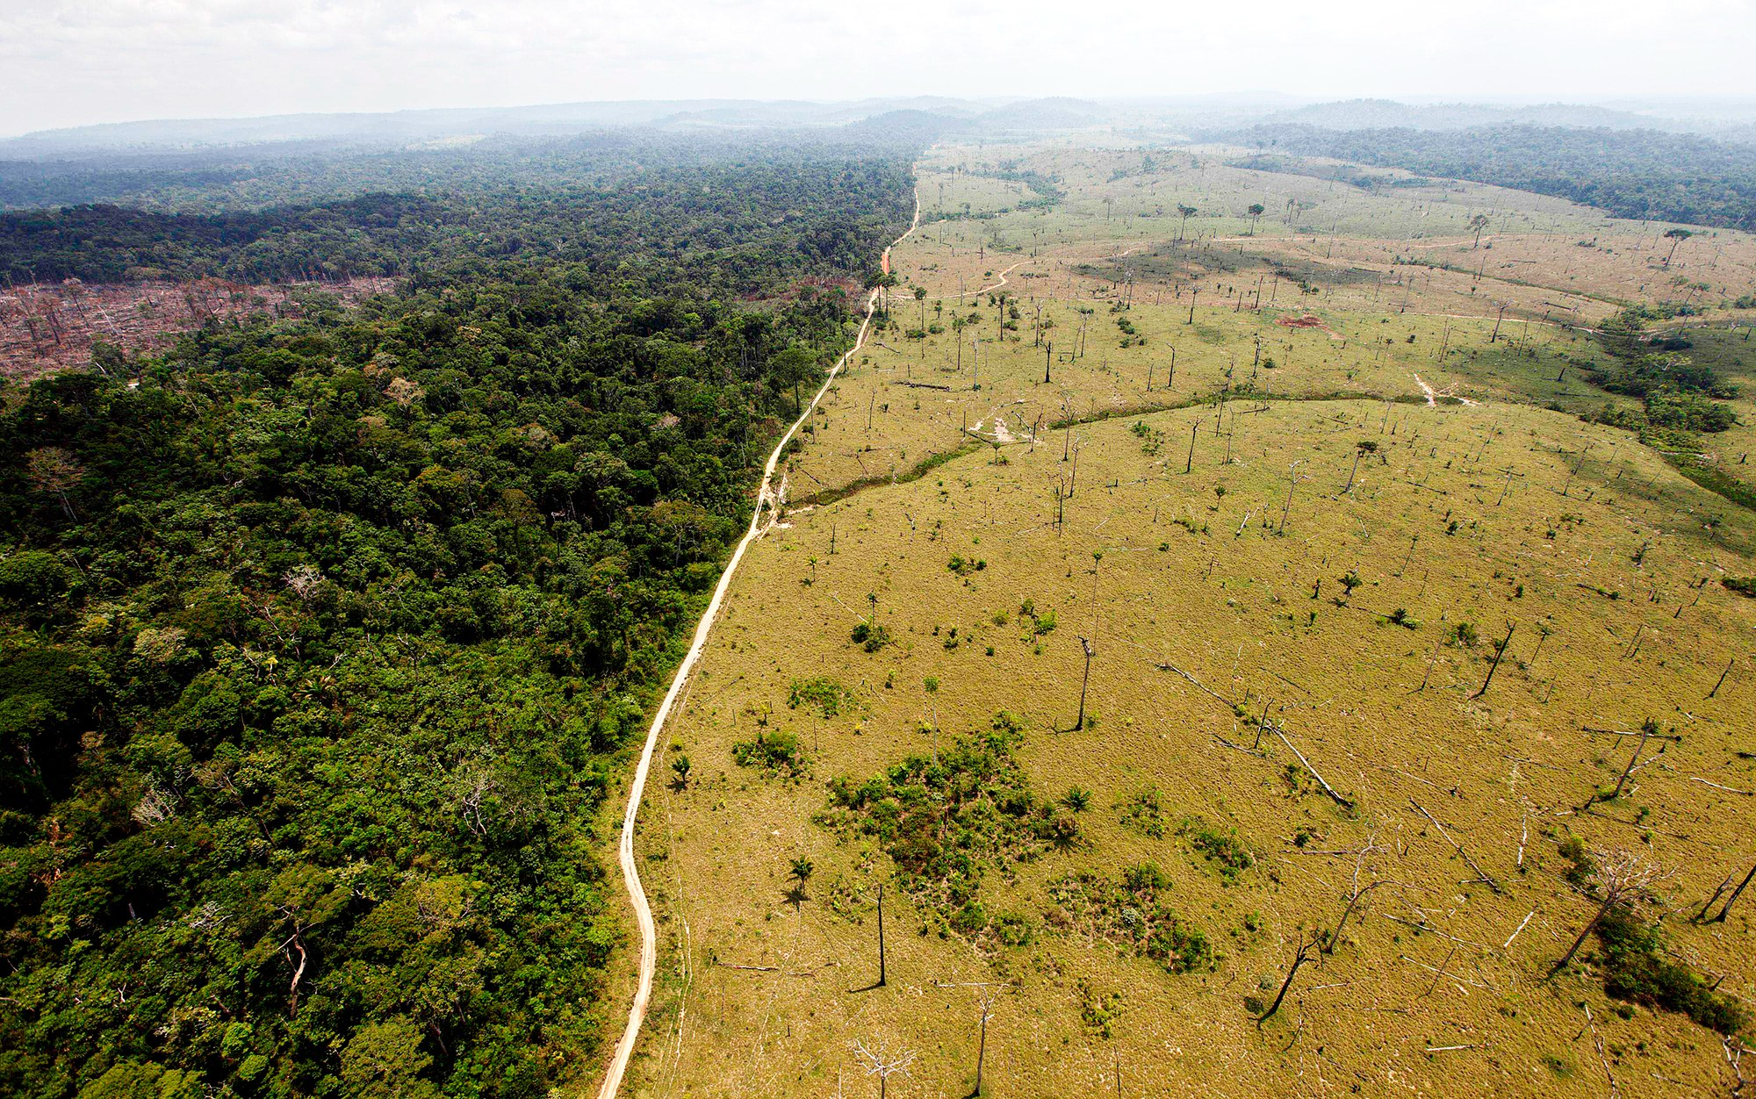
The removal of trees to clear an area of forest.
Deforestation

Slide 6
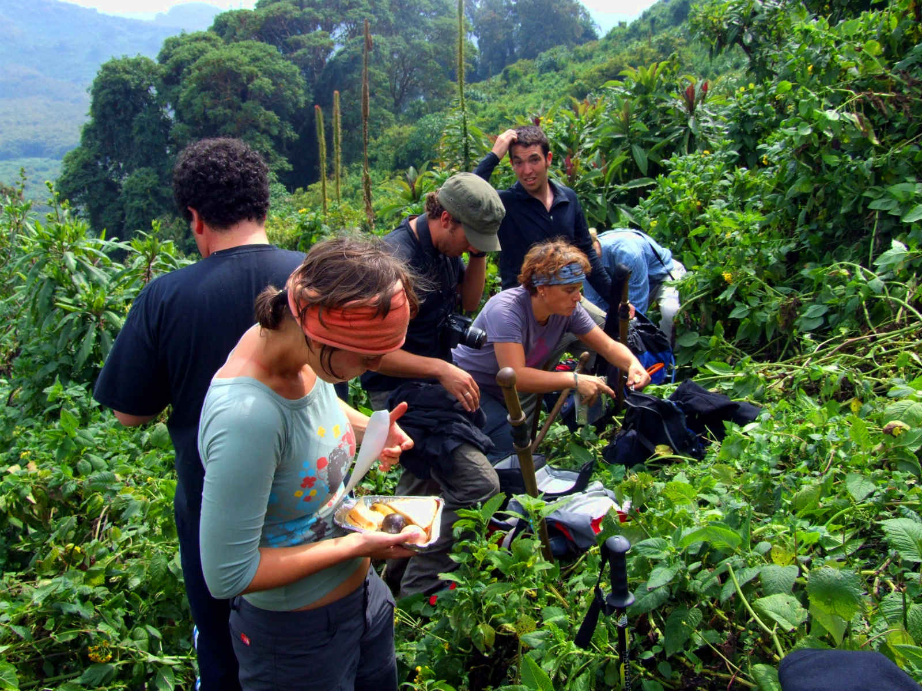
Responsible travel to natural areas that conserves the environment and sustains the wellbeing of the local people. It is usually carried out in small groups and has minimal impact on the local ecosystem.
Ecotourism

Slide 7
3.1.2.2 TROPICAL RAINFORESTS

Slide 8
3.1.2.2 TROPICAL RAINFORESTS

Slide 9
3.1.2.2 TROPICAL RAINFORESTS

Slide 10
3.1.2.2 TROPICAL RAINFORESTS

Slide 11
3.1.2.2 TROPICAL RAINFORESTS

Slide 12
3.1.2.2 TROPICAL RAINFORESTS

Slide 13
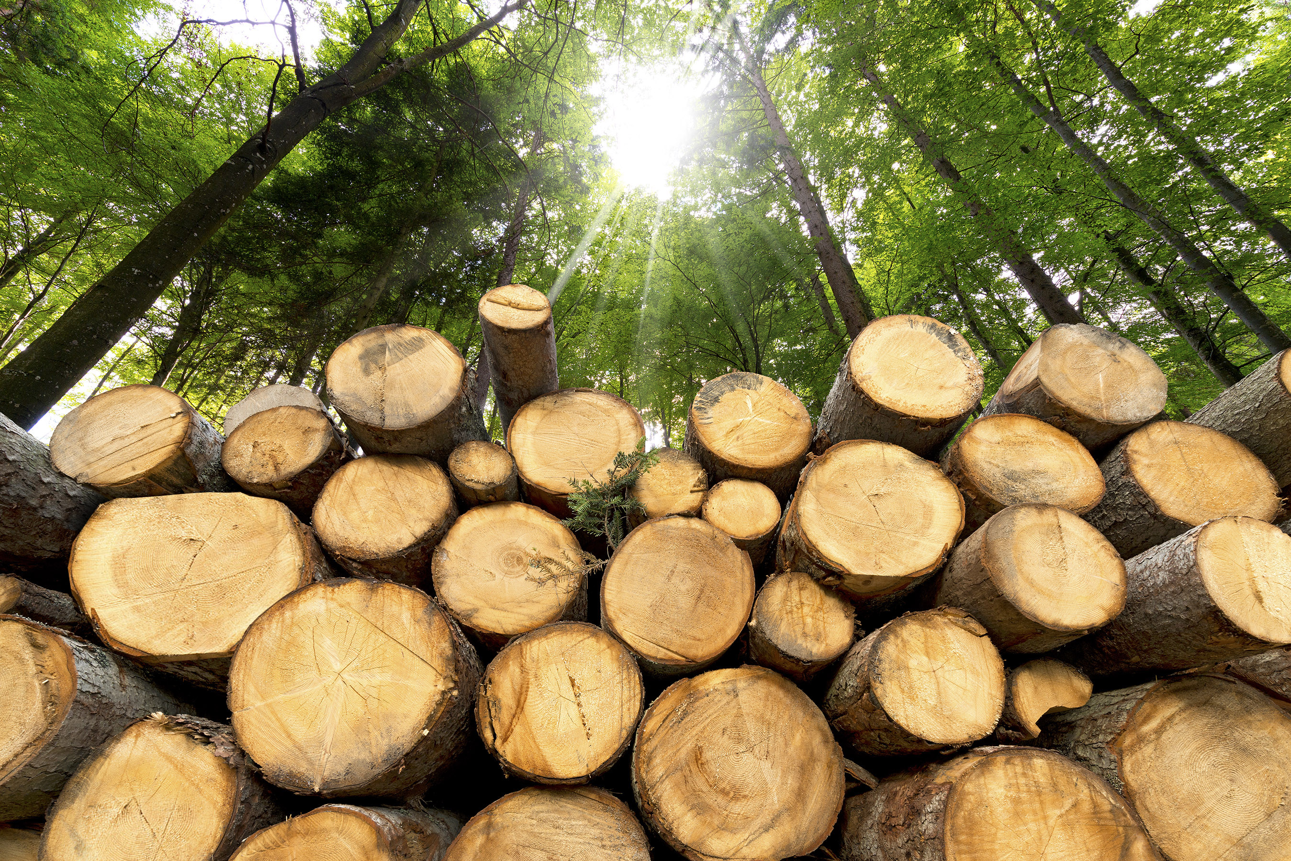
The business of cutting down trees and transporting the logs to sawmills.
Logging

Slide 14
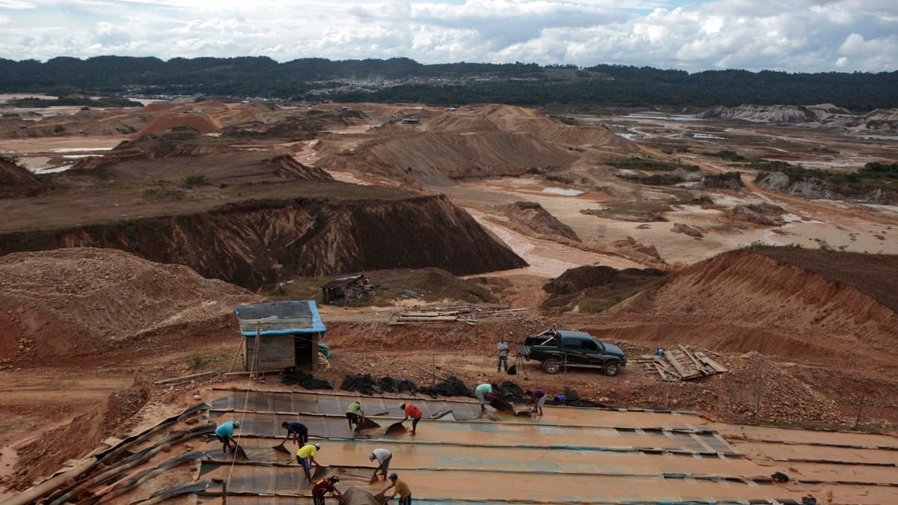
The removal of mineral resources from the earth. These resources include ores, which contain metals, such as iron and aluminium; precious stones, such as diamonds; building stones, such as granite; and fuels, such as coal and oil shale.
Mineral extraction

Slide 15
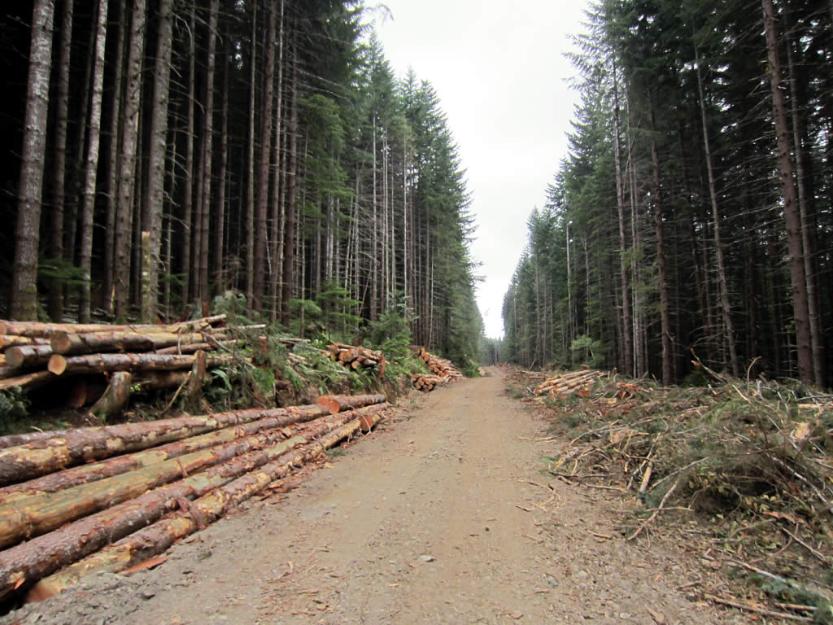
The cutting out of trees which are mature or inferior, to encourage the growth of the remaining trees in a forest.
Selective logging

Slide 16
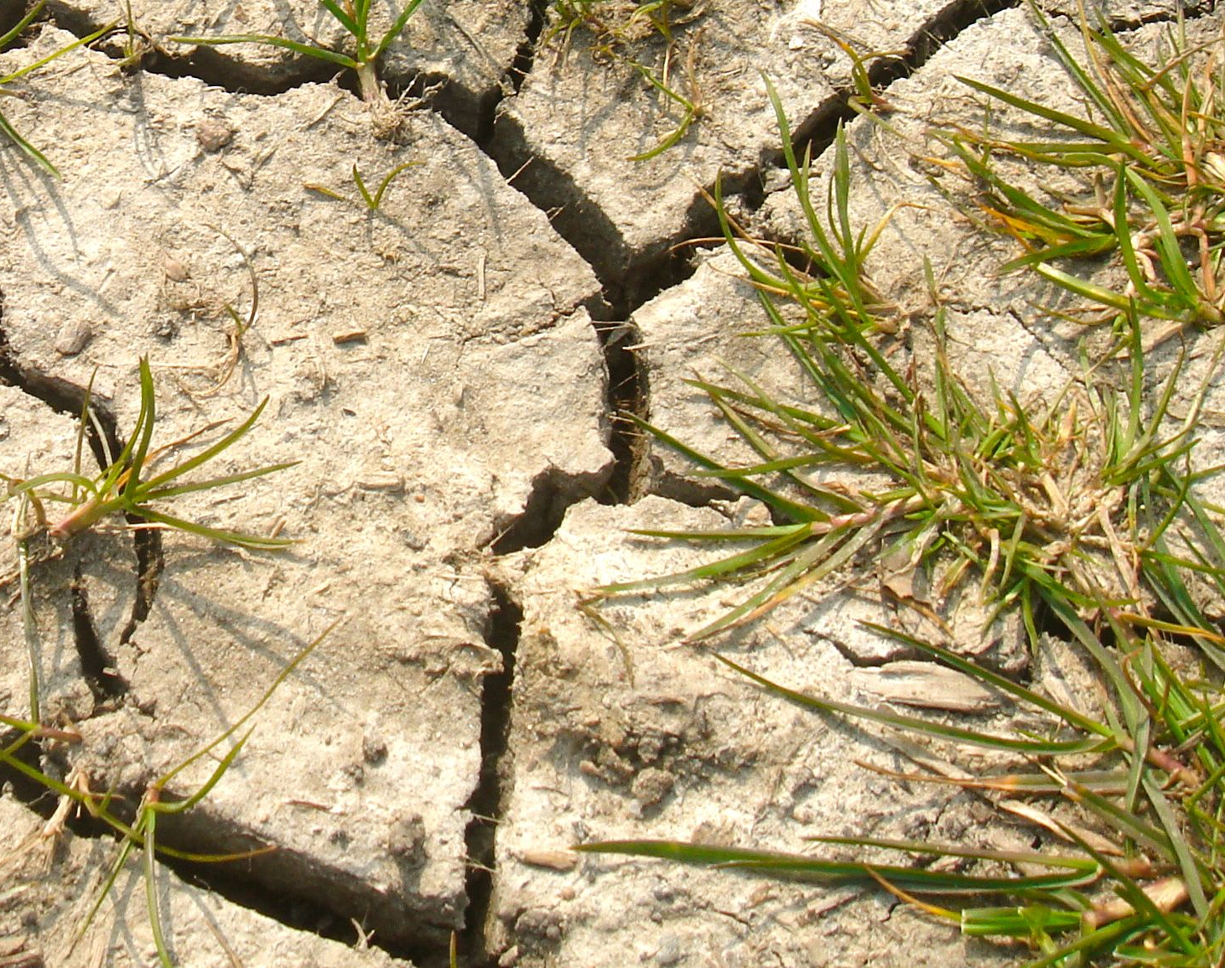
Removal of topsoil faster than it can be replaced due to natural (water and wind action), animal, and human activity. Occurs when the soil is dry or weak and can lead to desertification.
Soil erosion

Slide 17
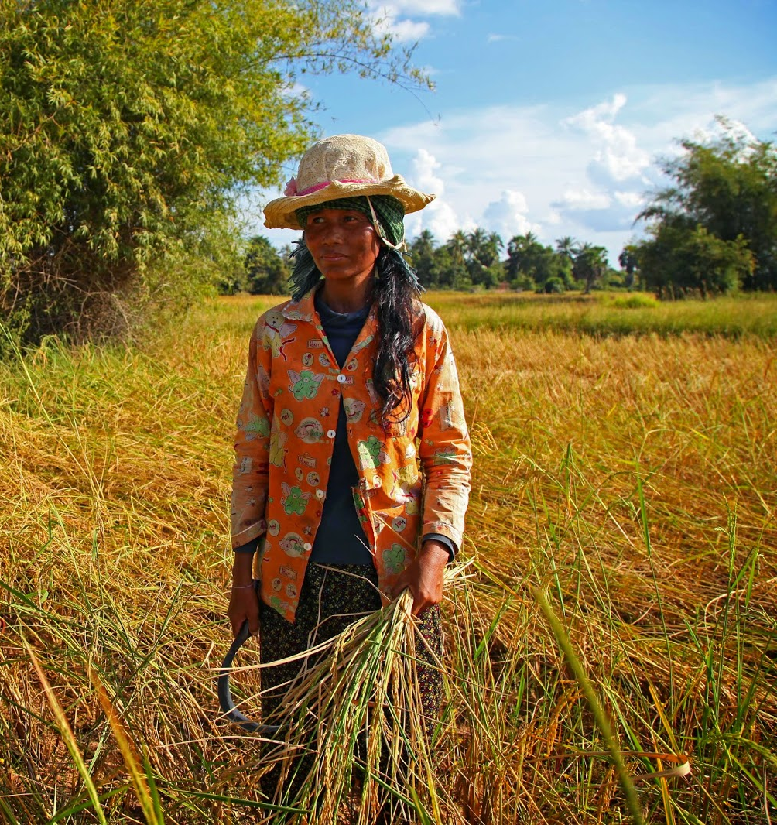
A type of agriculture producing food and materials for the benefit only of the farmer and their family.
Subsistence farming

Slide 18
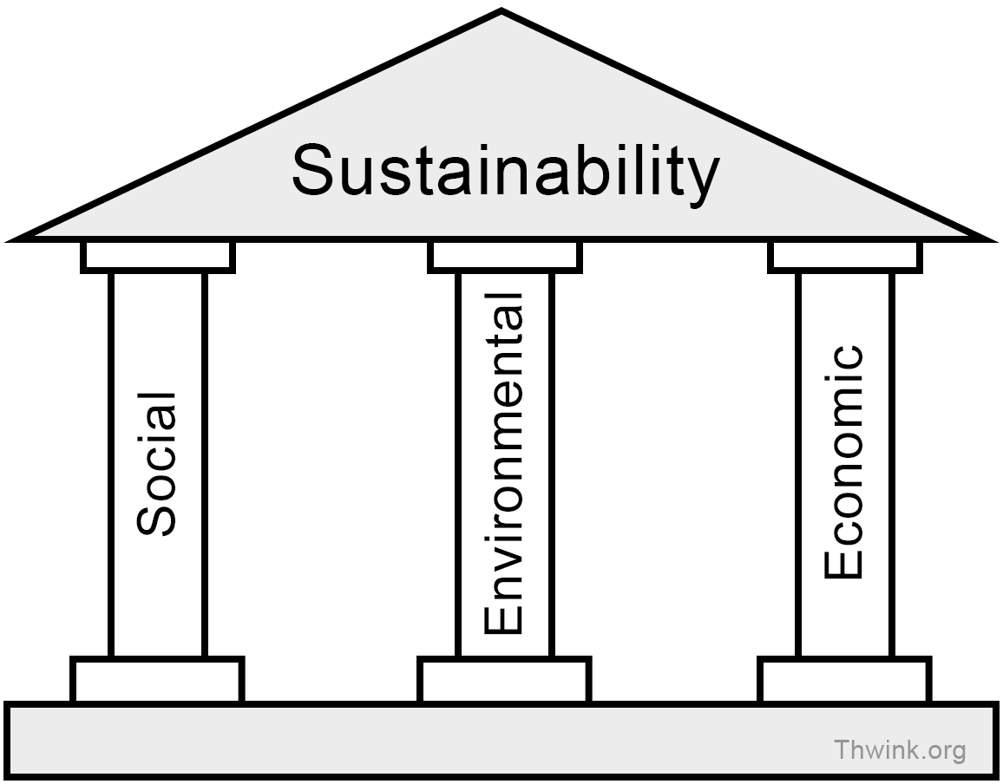
Actions and forms of progress that meet the needs of the present without hindering the ability of future generations to meet theirs.
Sustainability

Slide 19
3.1.2.2 TROPICAL RAINFORESTS

Slide 20
3.1.2.2 TROPICAL RAINFORESTS

Slide 21
3.1.2.2 TROPICAL RAINFORESTS

Slide 22
3.1.2.2 TROPICAL RAINFORESTS

Slide 23
3.1.2.2 TROPICAL RAINFORESTS

Slide 24
3.1.2.2 TROPICAL RAINFORESTS

Slide 25
The building of facilities to generate electricity; these often have devastating impacts on the environment (e.g. deforestation)
Energy development

Slide 26
Formal agreements between nations focused on the sustainable use of rainforest resources (e.g. 2006 International Tropical Timber Agreement).
International agreements (TRFs)

Slide 27
3.1.2.2 TROPICAL RAINFORESTS

Slide 28
3.1.2.2 TROPICAL RAINFORESTS

Slide 29
3.1.2.2 TROPICAL RAINFORESTS

Slide 30
3.1.2.2 TROPICAL RAINFORESTS

Slide 31
3.1.2.2 TROPICAL RAINFORESTS

Slide 32
3.1.2.2 TROPICAL RAINFORESTS

Slide 33
3.1.2.2 TROPICAL RAINFORESTS

Slide 34
3.1.2.2 TROPICAL RAINFORESTS

Slide 35
3.1.2.2 TROPICAL RAINFORESTS

Slide 36
3.1.2.2 TROPICAL RAINFORESTS

