Slide 1
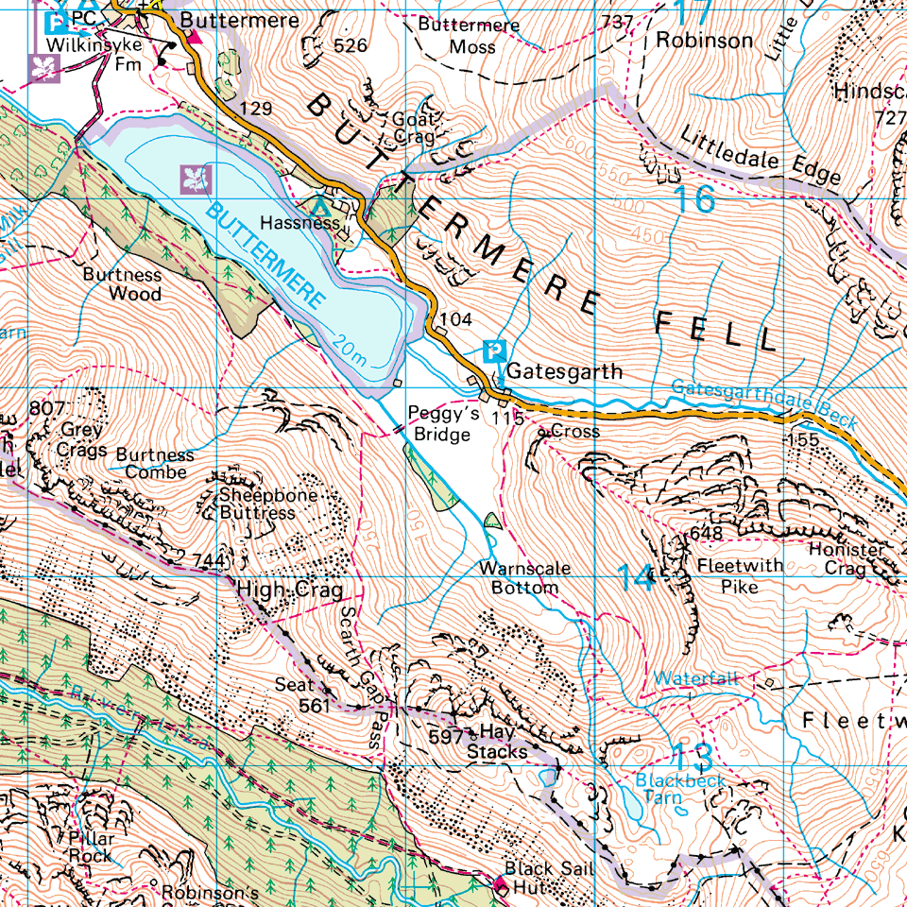
The maps most often used in exams. These include grid references and a key with various symbols.
3.4 Geographical skills
Most OS maps use a 1:25 000 map scale, meaning every 1 cm on the map is equal to 250 m on the ground.
Ordnance Survey map

Slide 2
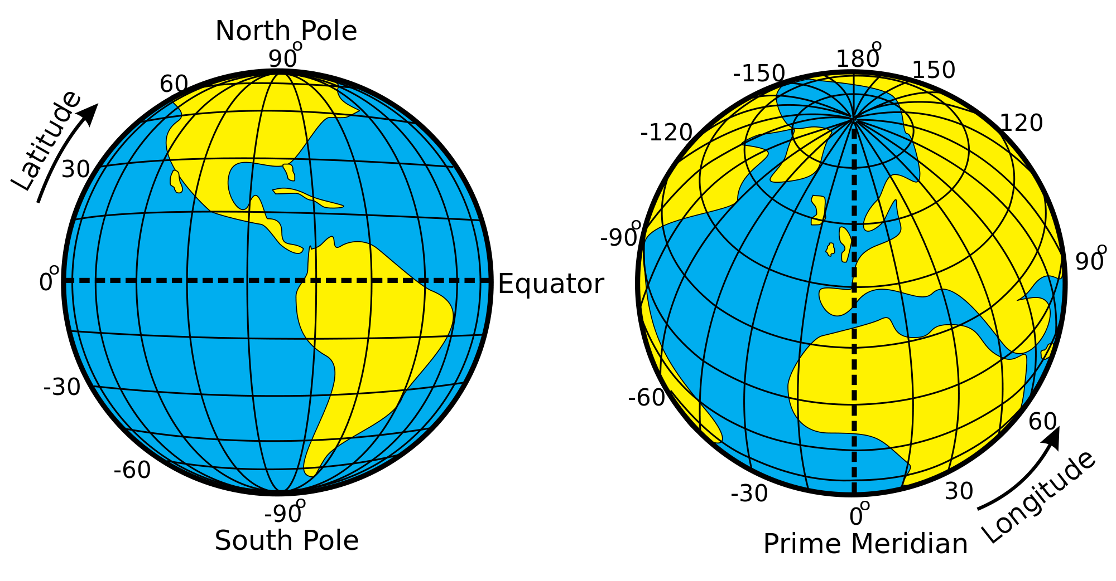
Lines of measurement used to determine the precise location of features on the surface of the Earth.
3.4 Geographical skills
Coordinates (both longitude and latitude) are measured in degrees. The Equator is at 0° whilst the Tropic of Capricorn is 23.5° south.
Latitude and longitude

Slide 3
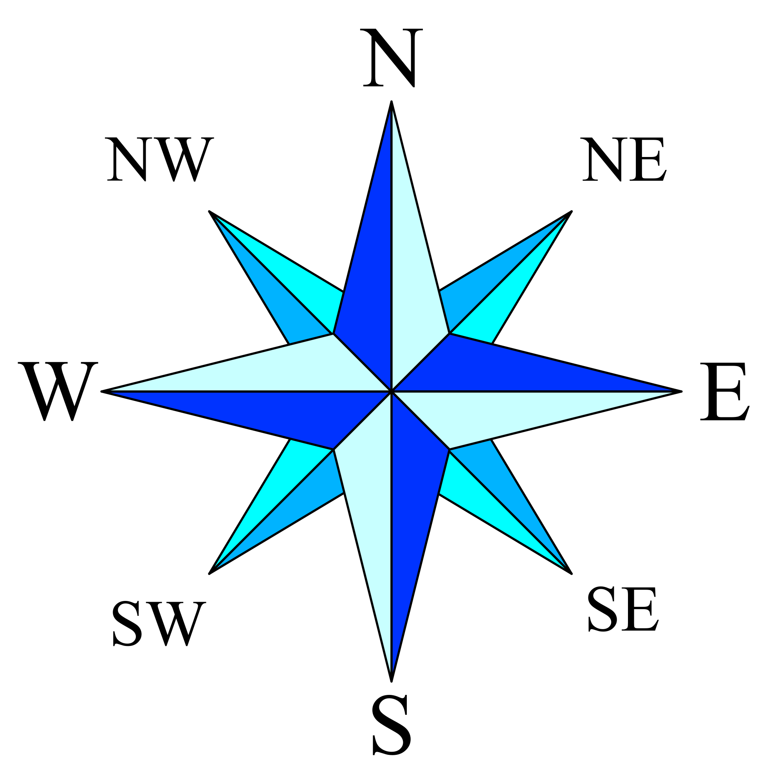
North, south, east and west are the 4 main points on a compass – Never Eat Shredded Wheat.
3.4 Geographical skills
London is south of Peterborough and Southend-on-Sea is to the east of London.
Compass direction

Slide 4
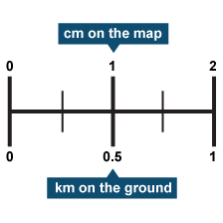
A feature of a map used to tell users how to work out distances.
3.4 Geographical skills
If the scale is 1:50,000 it means that every 1 cm on the map represents 50,000 cm in the real world.
Scale

Slide 5
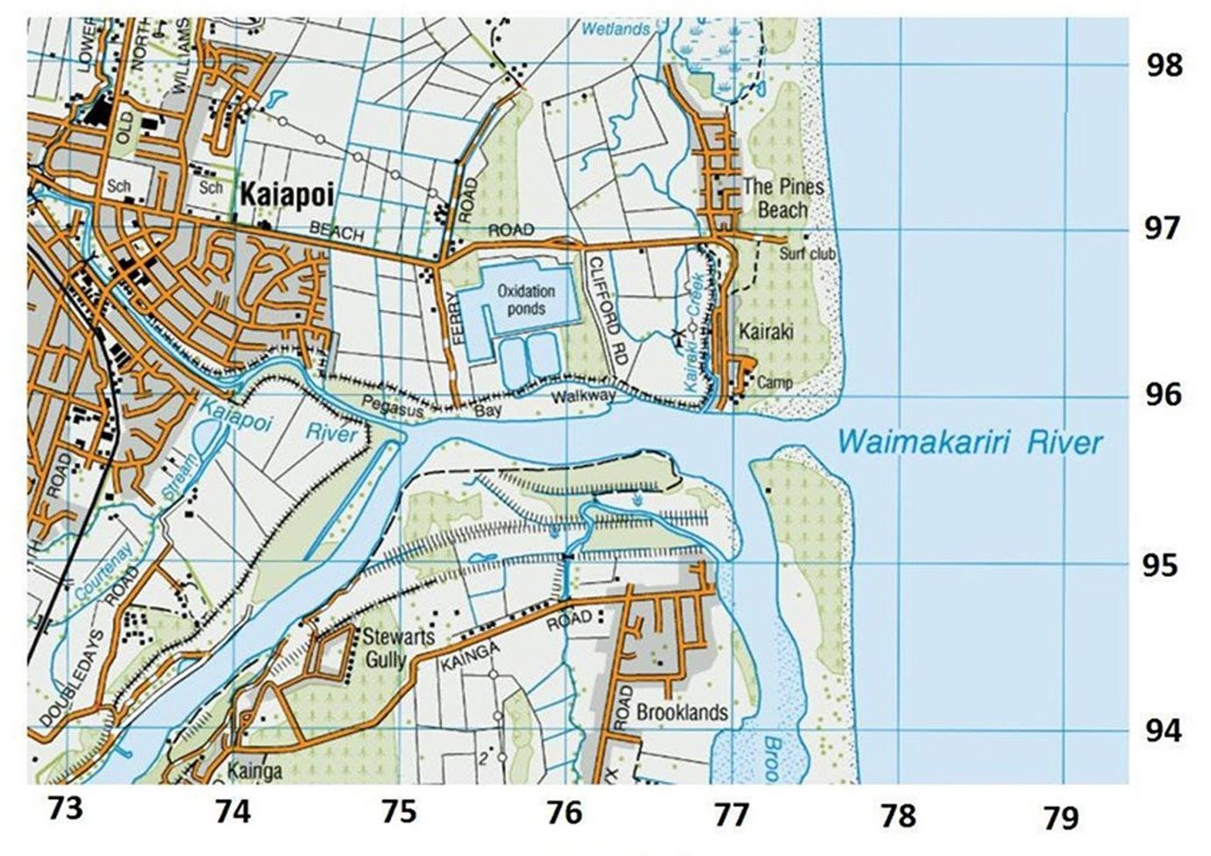
These measures of location on map can come in the form of 4 or 6 figures.
3.4 Geographical skills
When reading grid references always remember: along the corridor and up the stairs.
Grid reference

Slide 6
Exact height shown on a map by a black dot with a number next to it. The number is the height above sea level in metres.
3.4 Geographical skills
On the map below you see spot heights of 744m, 561m and 597m.
Spot height

Slide 7
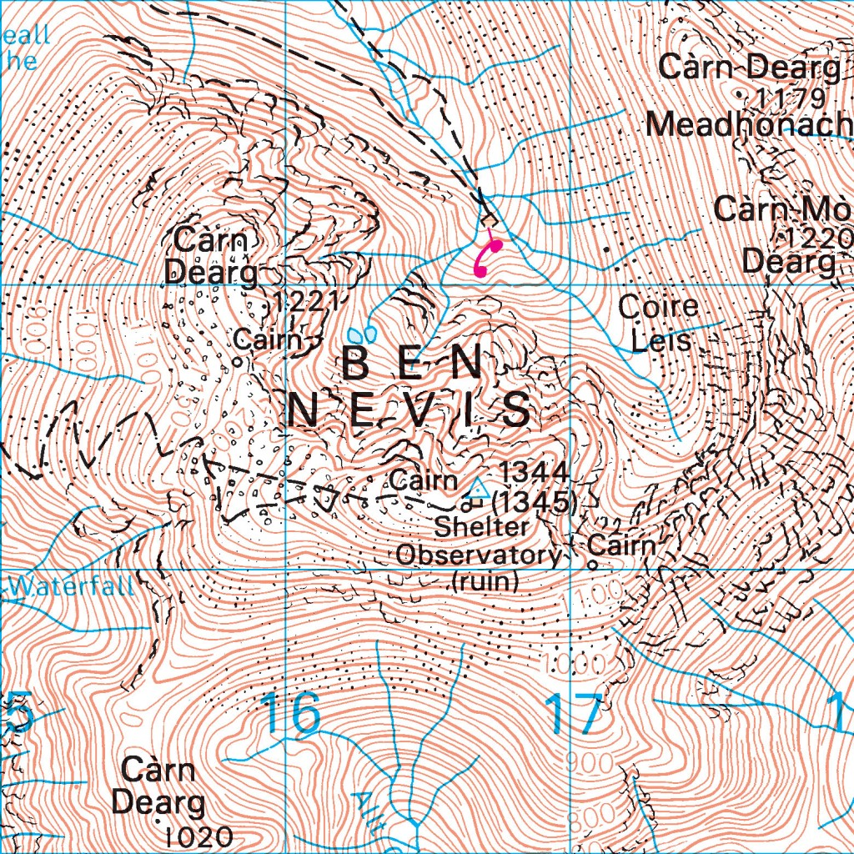
A method to show height on maps. The closer the isolines are together, the steeper the land.
3.4 Geographical skills
Ben Nevis the tallest mountain in the British Isles and it is seen below:
Contour lines

Slide 8
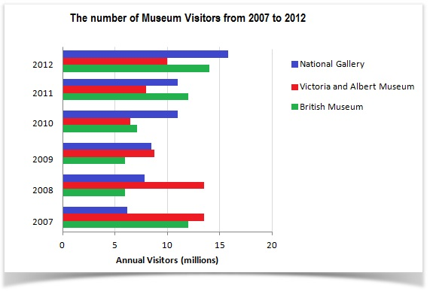
Where units of measurement cannot be split up (i.e. number of buildings – you can’t have 1.3 buildings!)
3.4 Geographical skills
Discrete data can only take certain values (e.g. whole numbers) and is mostly plotted on bar charts.
Discrete data

Slide 9
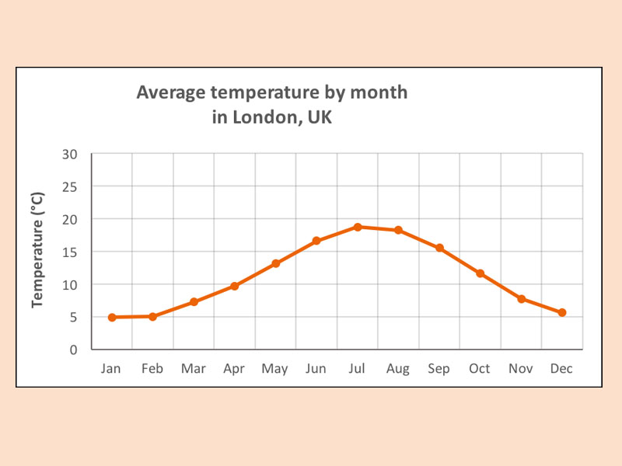
Data where the scale of measurement – e.g. distance - has meaning at all points between the numbers given. For example, we can travel a distance of 1.2 and 1.85 and even 1.632 miles.
3.4 Geographical skills
Temperature and humidity are both good examples of continuous data used by geographers.
Continuous data

Slide 10
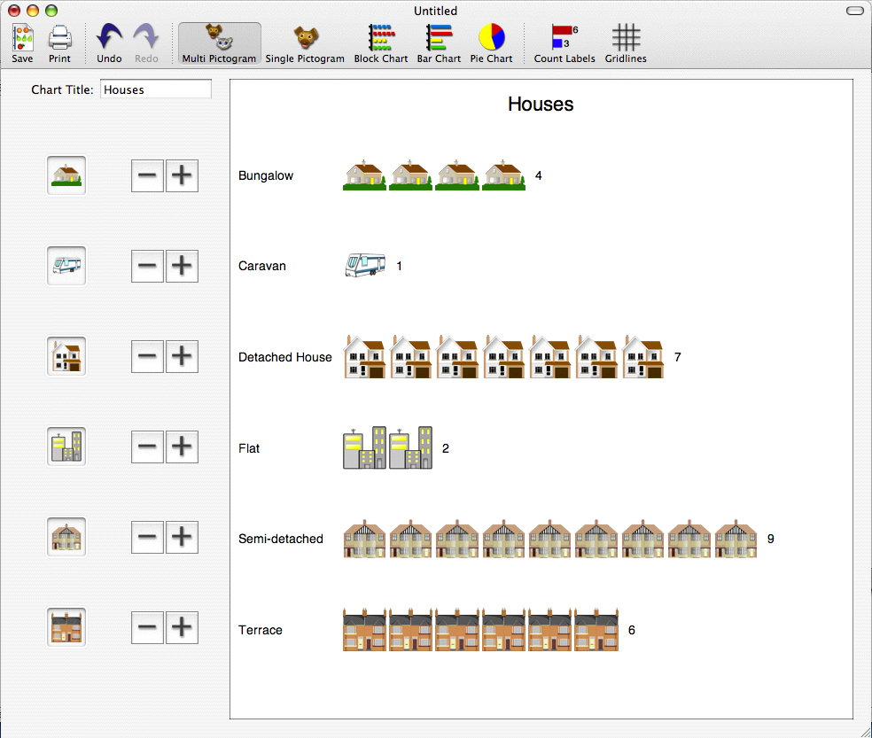
A visual form of data presentation which uses symbols to represent data.
3.4 Geographical skills
Pictograms must always include a key as they rely on symbols as opposed to data you can easily read.
Pictogram

Slide 11
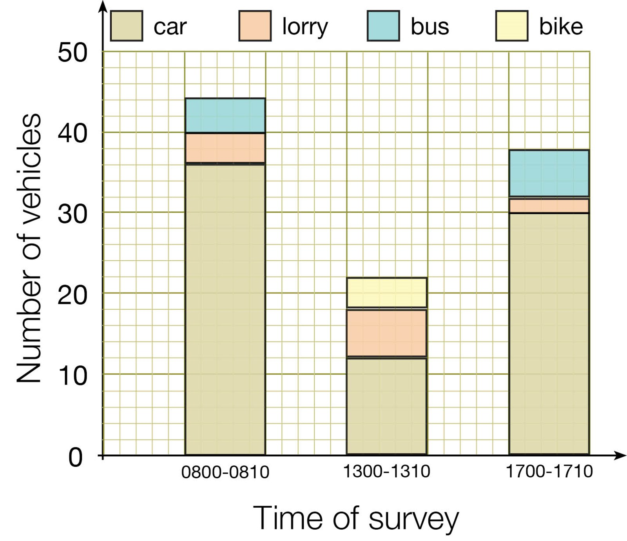
Divided bar charts are used to show the frequency in several categories, like ordinary bar charts. It is a type of compound bar chart. But unlike ordinary bar charts, each category is subdivided.
3.4 Geographical skills
These charts often use colour to differentiate categories.
Divided bar chart

Slide 12
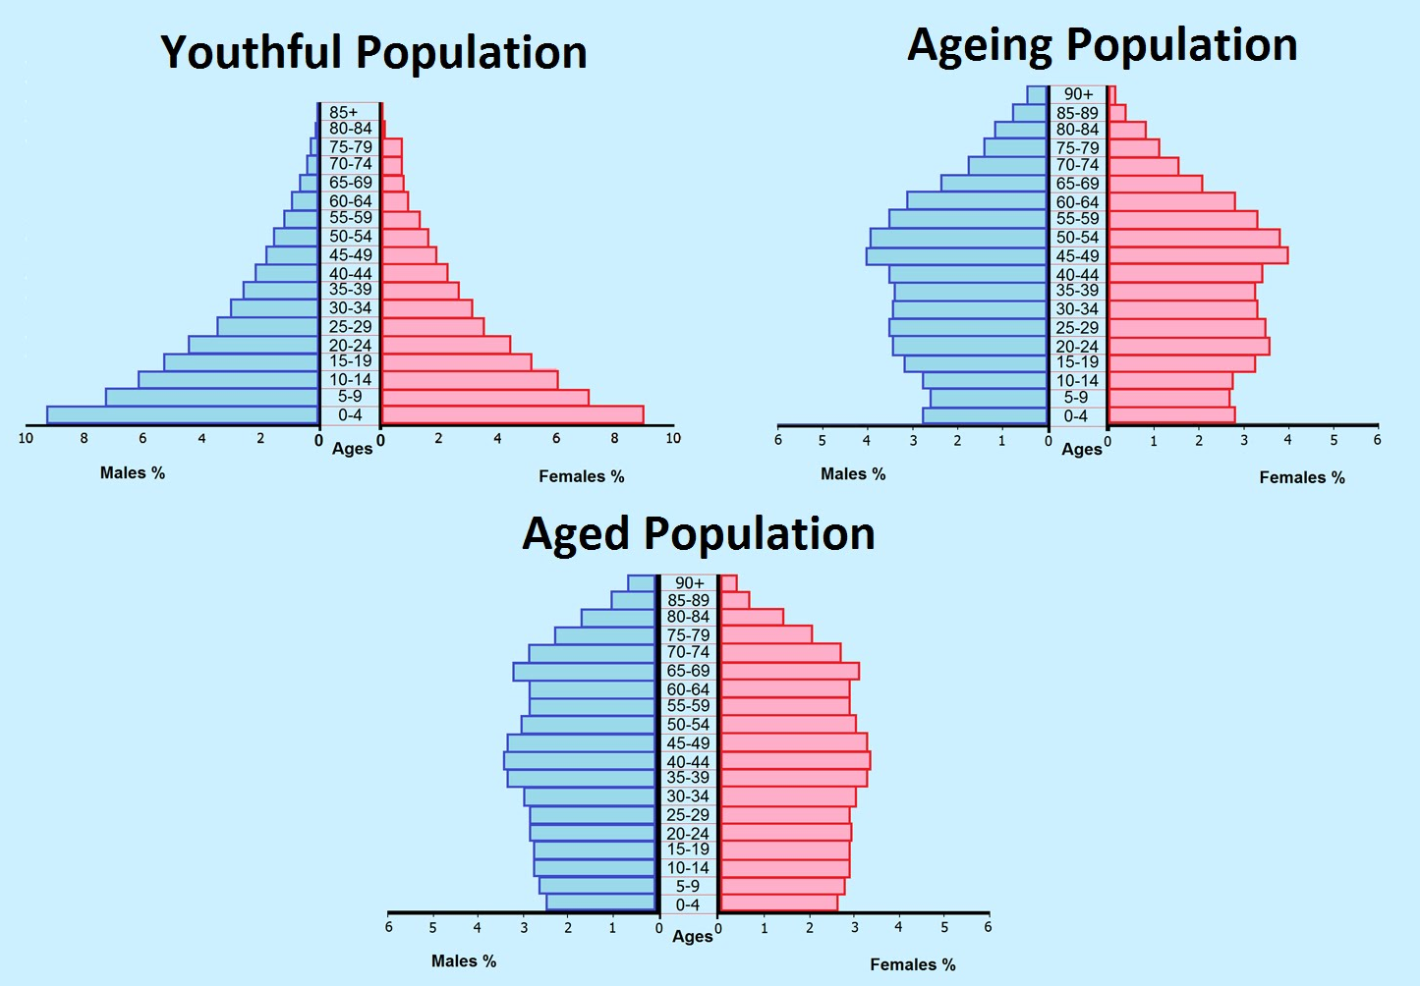
Bar charts that show how many people of different ages are living in a place or country.
3.4 Geographical skills
Population pyramids show the bars arranged sideways, rather than vertically. The x-axis shows the number of people, the y-axis shows their ages.
Population pyramid

Slide 13
Charts used to show the numbers of things (or frequency) along a continuous scale.
3.4 Geographical skills
Histograms are drawn using continuous data, so no gaps should be left between the bars!
Histogram

Slide 14
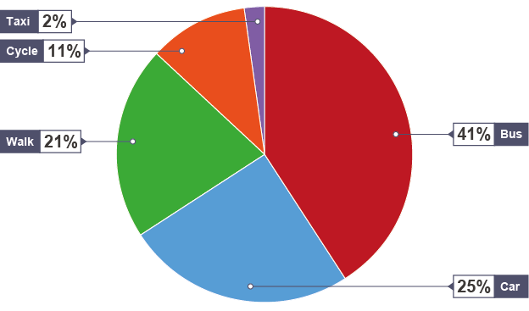
Circular charts used to show percentages as a circle divided into segments.
3.4 Geographical skills
Each piece of data is shown as a proportion of 360, because there are 360 degrees in a circle.
Pie chart

Slide 15
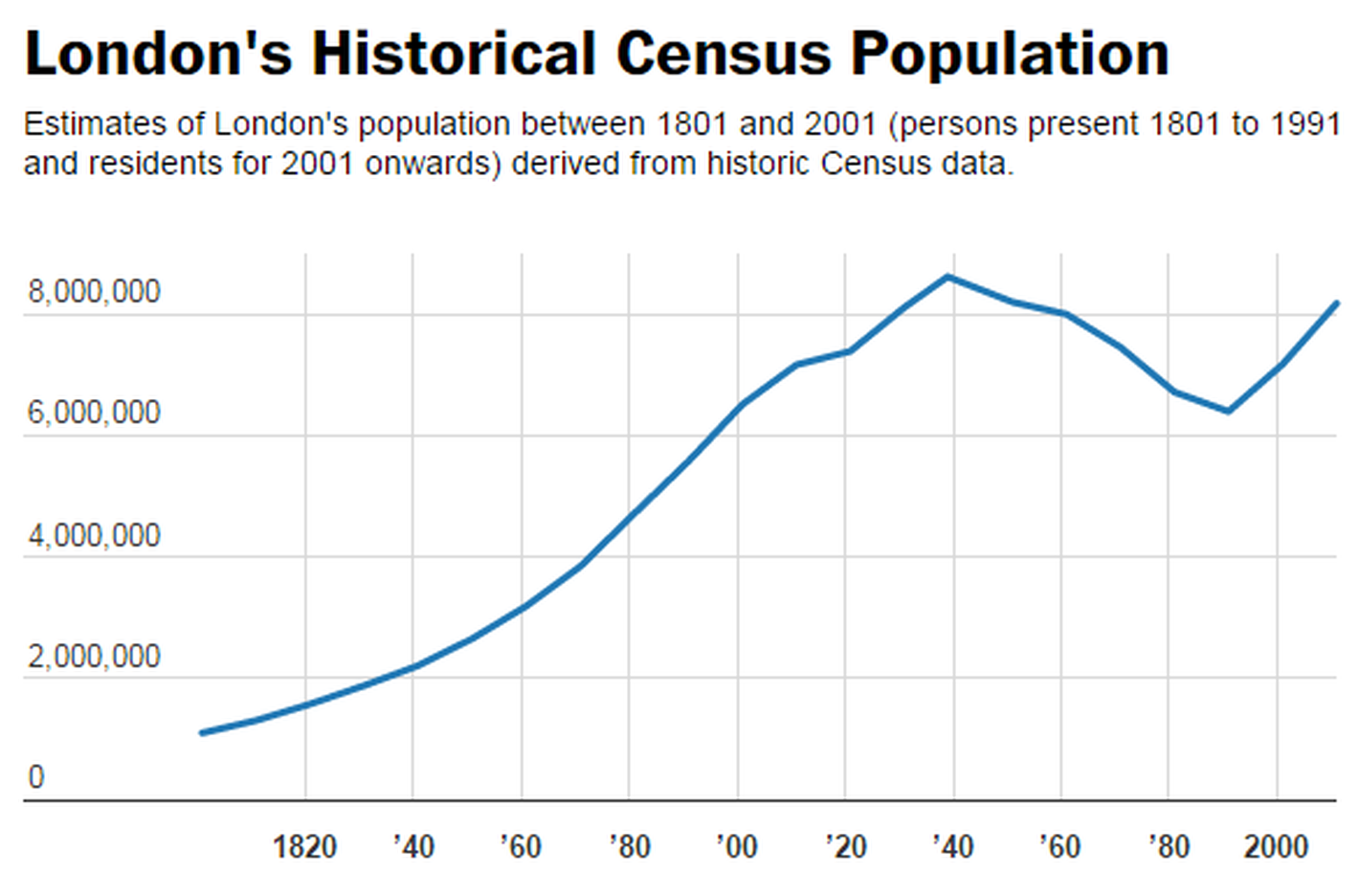
Graphs which show how data changes over time or space.
3.4 Geographical skills
The x-axis shows time or distance.
Line graph

Slide 16
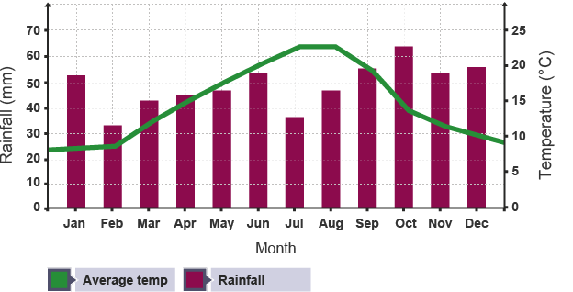
A graph showing climate which combines a bar chart and a line graph.
3.4 Geographical skills
The x-axis shows the months of the year and there are two y-axes to show average temperature and total rainfall. The temperature is shown as a line and the rainfall as bars.
Climate graph

Slide 17
Charts which show grouped data as rectangular bars.
3.4 Geographical skills
The number of tourists visiting a resort each month is a discrete data which can be plotted on a bar chart.
Bar chart

Slide 18
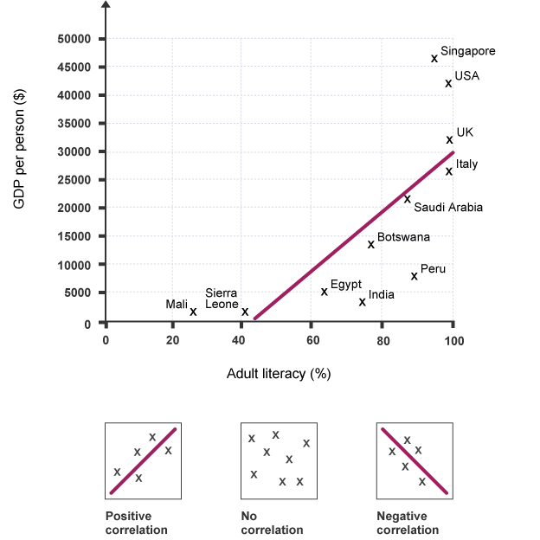
Graphs which show relationships between two sets of data. Points are located using the x and y-axis.
3.4 Geographical skills
A scatter graph could be used to show how literacy is related to GDP.
Scatter graph

Slide 19
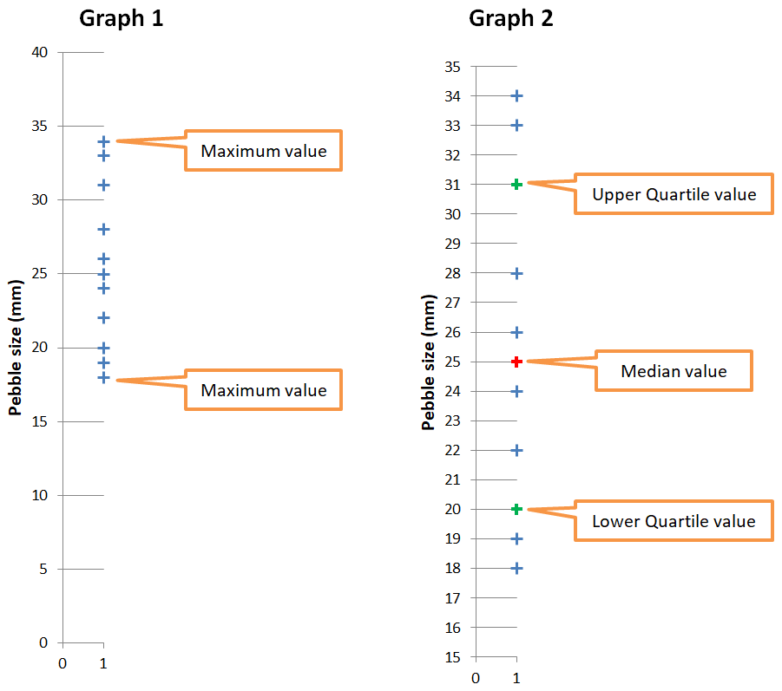
Graphs are used to show the range of values for a single set of data (e.g. house prices in a neighbourhood).
3.4 Geographical skills
Dispersion graphs should not be confused with scatter graphs, despite the similar definition of both words!
Dispersion graph

Slide 20
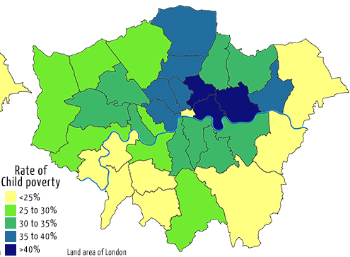
Show interval data (data that is linked) as colours. They are sometimes shaded in using one colour, where the darker shades represent high numbers and the lighter shades represent low numbers.
3.4 Geographical skills
A choropleth map needs a key to explain what the different shades mean.
Choropleth map

Slide 21
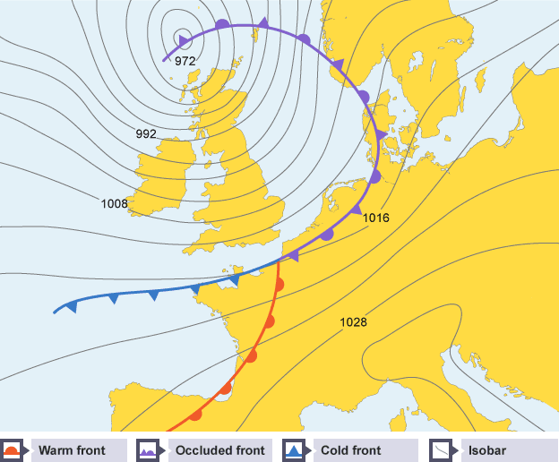
Isoline maps show lines that join up areas or values that are equal.
3.4 Geographical skills
Atmospheric pressure is shown using an isoline map. The areas of equal pressure are joined using a line.
Isoline map

Slide 22
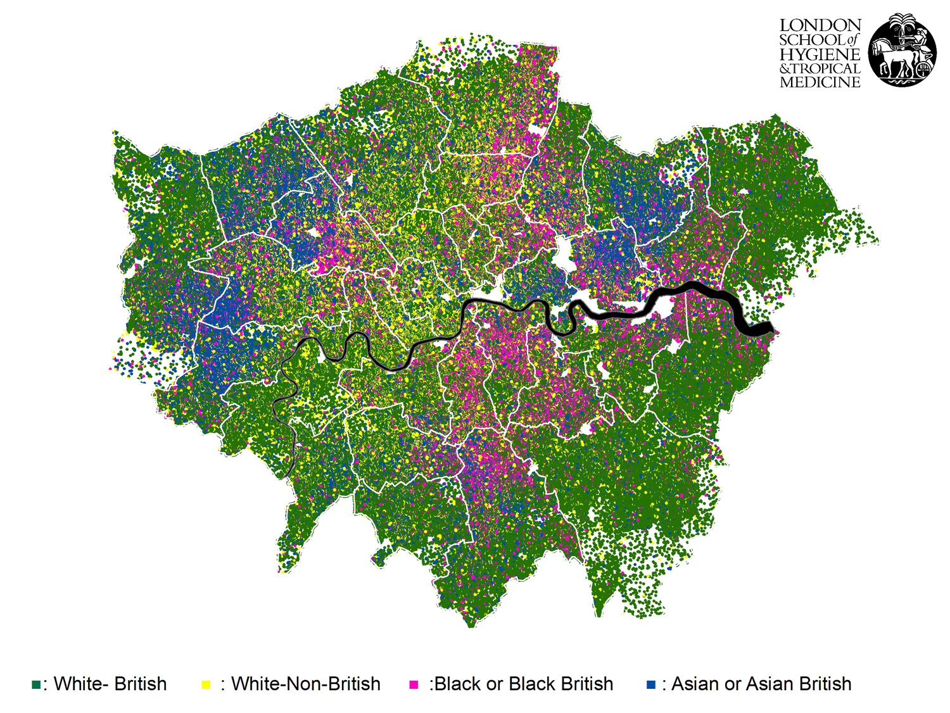
Dot maps show information as individual dots on a map. Each dot might represent more than one of something.
3.4 Geographical skills
In this ethnic dot map of London, each dot represents 10 people.
Dot map

Slide 23
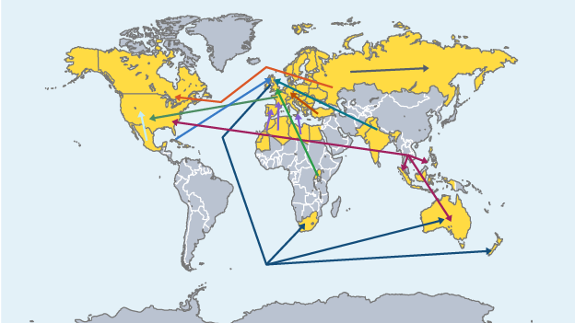
Lines on a map showing a general direction of movement.
3.4 Geographical skills
World trade patterns shown using desire lines.
Desire line (map)

Slide 24
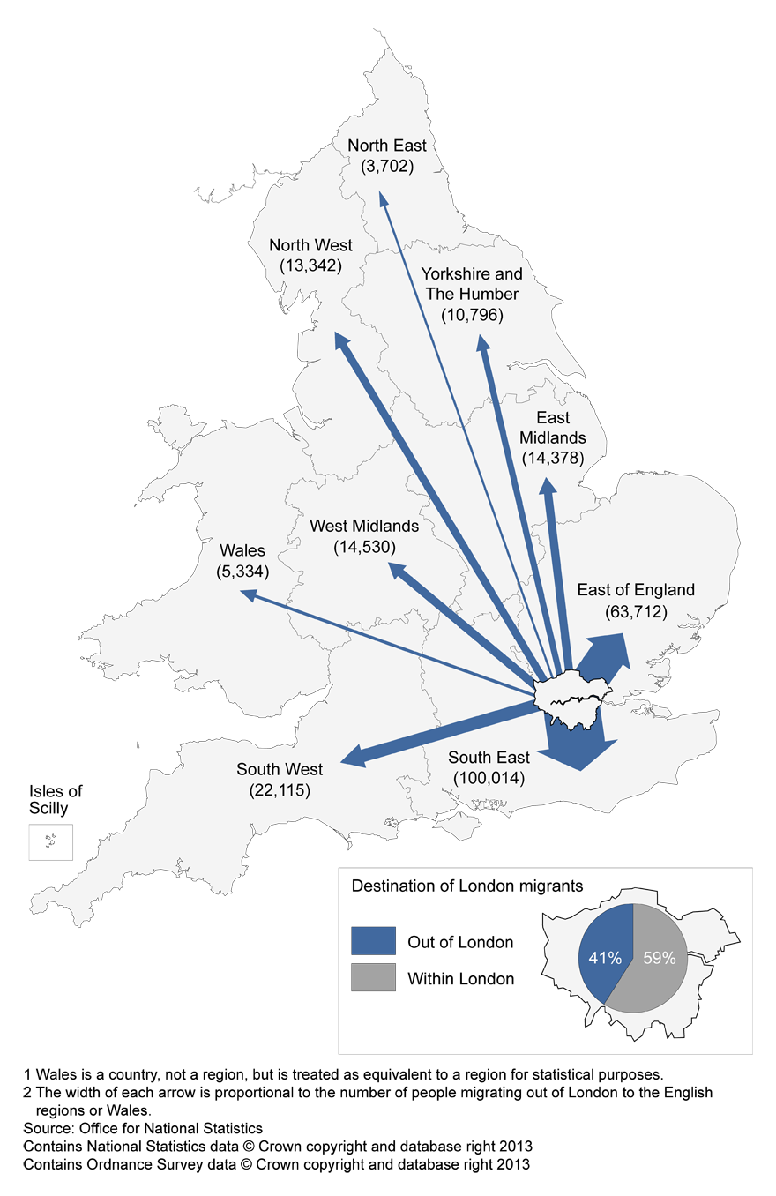
Lines on a map showing the exact path of movement.
3.4 Geographical skills
The movement of Londoners to other areas in the UK (2012); the wider the larger, the greater the flow.
Flow line (map)

Slide 25
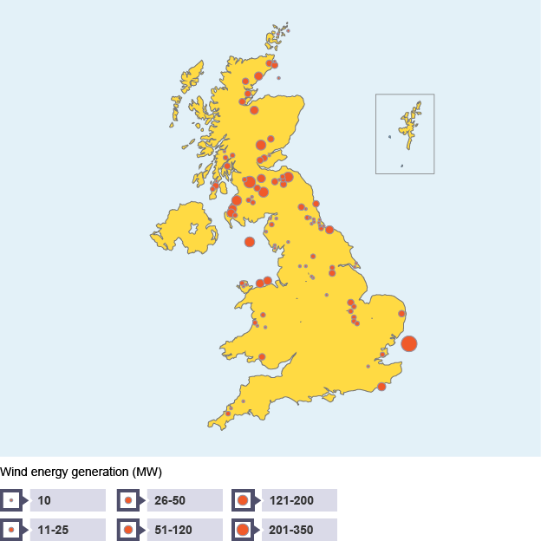
Symbols scaled according to the size of data (e.g. number of crimes) added to maps to show differences between places.
3.4 Geographical skills
The same symbol appears larger or smaller, depending on how something changes.
Proportional symbols

Slide 26
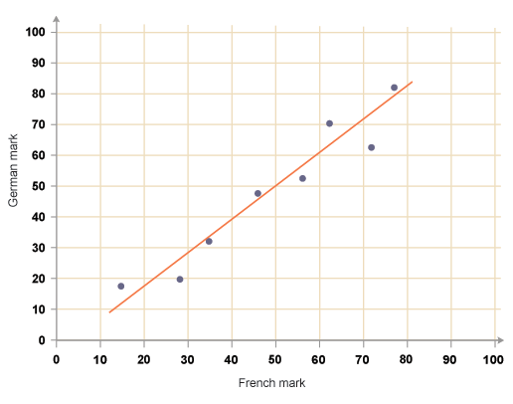
A line drawn on scatter graphs which helps to show correlations, or patterns within the data.
3.4 Geographical skills
The line of best fit runs through the middle of a collection of points on the graph, ideally with an equal number of points on either side of the line.
Line of best fit

Slide 27
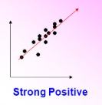
When the points are very close to the line of best fit.
3.4 Geographical skills
Here the two variables are related to one another - as one changes, so does the other.
Strong correlation

Slide 28
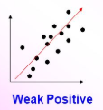
When the points are far away from the line of best fit.
3.4 Geographical skills
Here the two variables are not necessarily related to one another - a change in one does not mean a change in the other.
Weak correlation

Slide 29
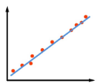
When an increase in one factor is mirrored by an increase in another.
3.4 Geographical skills
The line of best fit goes from the bottom left to the top right.
Positive correlation

Slide 30
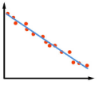
When an increase in one factor is mirrored by an decrease in another.
3.4 Geographical skills
The line of best fit goes from the top left to the bottom right.
Negative correlation

Slide 31
A line graph which shows a sideways view of a landscape.
3.4 Geographical skills
Cross sections of river depths are drawn using negative numbers so that the line graph looks like depth, rather than height.
Cross section

Slide 32
Selecting a person to interview or site to measure, at random.
3.4 Geographical skills
Random sampling is unbiased as particular people or places are not specifically selected.
Random sampling

Slide 33
Collecting data in an ordered or regular way.
3.4 Geographical skills
In a systematic sample you might measure noise pollution every 10 metres along a street.
Systematic sampling

Slide 34
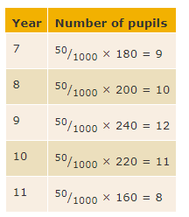
Dividing sampling into groups, e.g. five people from each age year group in a school.
3.4 Geographical skills
The formula for working out a stratified sample is:
(size of whole sample ÷ size of population) × size of layer
Stratified sampling

Slide 35
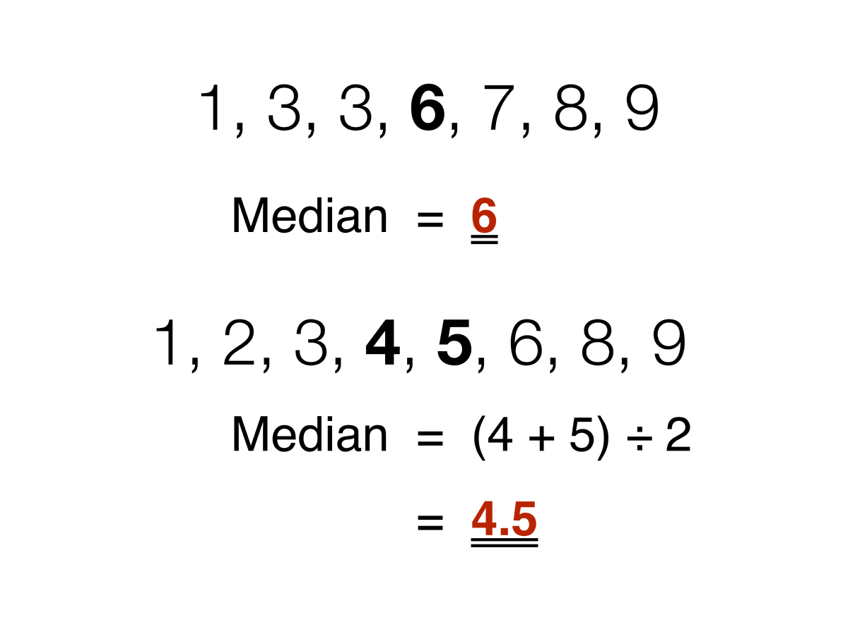
This is the middle value in a data set.
3.4 Geographical skills
The median is found by ordering the numbers in ascending order and looking for the middle number.
Median

Slide 36
The average number in a data set.
3.4 Geographical skills
The mean is calculated by adding up all the numbers and dividing by the total number of numbers.
Mean (average)

Slide 37
The difference between the largest and smallest number in a set of data.
3.4 Geographical skills
The range is more easily found by ordering the numbers in ascending order (smallest to largest).
Range

Slide 38
These are the values that divide the list of numbers into equal quarters.
3.4 Geographical skills
Lower quartile is the (n + 1) ÷ 4 ^{th} value.
Upper quartile is the 3 (n + 1) ÷ 4 ^{th} value.
Lower & upper quartiles

Slide 39
This is the difference between the upper quartile and lower quartile.
3.4 Geographical skills
Interquartile range

Slide 40
This is the number that occurs most often in a set of data.
3.4 Geographical skills
Mode

Slide 41
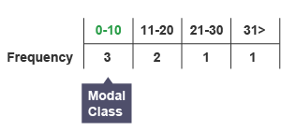
The group with the highest frequency.
3.4 Geographical skills
Modal class

Slide 42
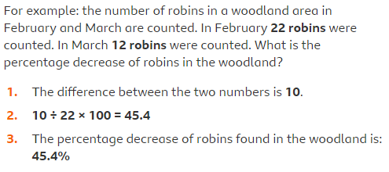
The percent by which a certain figure has fallen.
3.4 Geographical skills
Percentage decrease =
(decrease ÷ original number) × 100
Percentage decrease

Slide 43
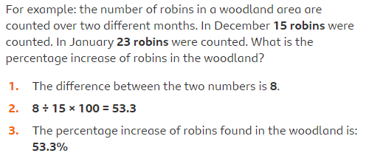
The percent by which a certain figure has risen.
3.4 Geographical skills
Percentage increase =
(increase ÷ original number) × 100
Percentage increase

Slide 44
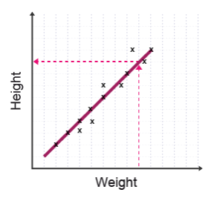
When a value is found within the data set, using the line of best fit.
3.4 Geographical skills
The value was not originally plotted, but can be read off the line of best fit.
Interpolate trend

Slide 45
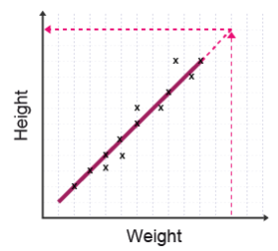
When a value is found outside of the data set
3.4 Geographical skills
Extrapolation may provide uncertain results as it is based on extending the line of best fit beyond a known set of data.
Extrapolate trend

