Slide 1
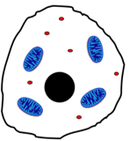
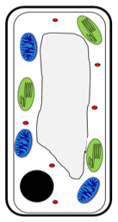
What is a eukaryotic cell?
What is a prokaryotic cell?
Label the bacterial cell
State what happens in the different stages of the cell cycle
Stage 1 –
Stage 2 –
Stage 3 -
Topic 1 Cell Biology
What is therapeutic cell cloning?
Label the animal cell
Describe the function of each of these organelles
Highlight the organelles only found in plants green
Nucleus
Cytoplasm
Cell membrane
Mitochondria
Ribosomes
Cell wall
Chloroplasts
Vacuole
What is the job of the flagellum?
What is a plasmid?
What is the job of the slime layer?
Define the following terms:
Chromosome –
Gene –
DNA –
Give one way in which each of the following cells is adapted to its job:
Nerve cell –
Muscle cell –
Sperm cell –
Root hair cell –
Xylem cell –
Phloem cell -
Label the plant cell
Why is mitosis important?
What is an embryonic stem cell?
What is an adult stem cell?
What is meristem tissue?
What 3 factors affect the rate of diffusion:
What is a plant cell wall made out of?
Define diffusion:
What is the equation for magnification?
Define osmosis:
List some advantages of using stem cells:
List some disadvantages of using stem cells:
Give one example of diffusion in plants and one in animals
What is meant by the terms:
Resolution –
Magnification -
Define active transport:
Give an example of active transport in plants:

Slide 2
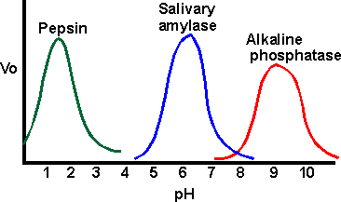
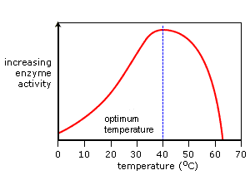
Define the following terms and give an example of each:
Cells –
Tissues –
Organs –
Organ system -
What is the role of:
Pancreas –
Liver –
Small intestine –
Large intestine –
Rectum –
Anus –
Describe how you would use:
Benedict’s reagent to test for sugar –
Iodine to test for starch –
Biuret solution to test for protein –
Draw a diagram here to show how enzymes work:
Where is bile produced:
Where is bile stored:
Describe the 2 jobs of bile:
1)
2)
Topic 2 Organisation
Label the digestive system
Digestive enzymes
Enzyme | What it breaks down | What it breaks down into | Where it is produced | Where it works
Amylase
Carbohydrase
Protease
Lipase
Using the graph
What is the optimum pH of:
Pepsin:
Salivary amylase:
Alkaline phosphatase:
Enzymes are made of ____________. These are made up of _________ _______. Enzymes are ______________ ___________. They ________ up reactions by lowering the _____________ ________. Enzymes have an _________ _______. This is where the substrate joins. The active site is _____________________ and ___________ to the corresponding substrate. Enzymes speed a reaction up but do not ________ it.
Words: Protein, specific, active site, change, complementary, biological catalysts, amino acids, activation energy, speed.
Explain this graph:
What is meant by the term ‘optimum temperature’?
Describe this graph:
What is the role of the small intestine?
How is the small intestine adapted for it’s role?
What is meant by the ‘lock and key theory’?

Slide 3
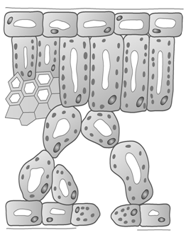
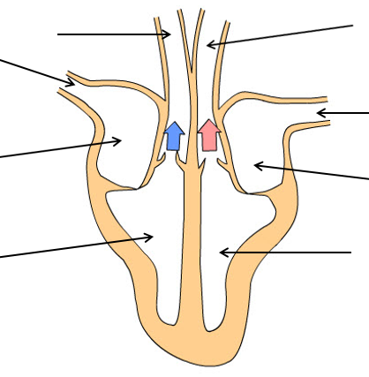
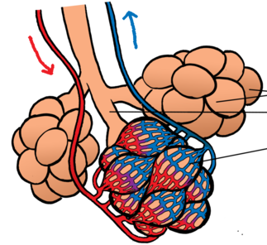
Label the left atrium, left ventricle, right atrium, right ventricle, aorta, vena cava, pulmonary artery and pulmonary vein on the diagram
What is the job of the heart?
Where does the left ventricle pump blood to?
Where does the right ventricle pump blood to?
What is the function of an artery?
How is an artery adapted for its function?
What is the function of a vein?
How is a vein adapted for its function?
What is the function of a capillary?
How is a capillary adapted fro its function?
Label the epidermis, spongy mesophyll, palisade mesophyll, xylem, phloem, guard cells and stomata.
What is the job of the pacemaker?
Why might someone have an artificial pacemaker fitted?
Label the trachea, bronchi and alveoli
Label the capillary network
What is transpiration?
What factors affect the rate of transpiration?
What is translocation?
What is coronary heart disease?
What is cancer?
What is the difference between a benign and a malignant tumour?
What is the function of the xylem?
What the function of the phloem?
In what ways can a heart valve become faulty?
How can a faulty heart valve be treated?
What is the function of:
Epidermis tissue –
Palisade mesophyll –
Spongy mesophyll –
Meristem tissue –
Name some risk factors for the following diseases:
Type 2 diabetes –
Cardiovascular disease –
Cancer –
Lung cancer/ lung disease –
What is a coronary artery and where would you find them?
How does smoking and alcohol consumption effect unborn babies?

Slide 4
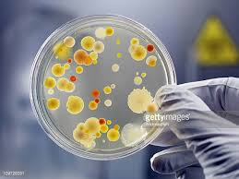
Define the following terms and give an example of each:
Communicable –
Bacteria –
Virus –
Fungi –
What are the different ways pathogens are spread?
By air –
Direct contact –
By water –
(BIOLOGY ONLY) Describe how you would grow useful bacteria in a science lab and how you ensure it is done safely:
(BIOLOGY ONLY) Calculating bacterial growth:
Equation for number of times bacteria divide in a set amount of time.
Equation for calculating the number of bacteria in a population.
Compare the effectiveness of antibiotics and disinfectants using ∏r² on the image below.
Topic 3 Infection & Response
Different diseases
Name | Bacteria / Virus / Fungi / Protist | Symptoms | Problems | Treatments
HIV / AIDS
Salmonella
Malaria
Rose black spot
Gonorrhoea
Measles
Tobacco Mosaic Virus
(BIOLOGY ONLY) Describe different plant defences:
Explain what a vaccine is and how it works.
Describe how herd immunity works.
Describe the stages of drug testing and why each stage is important:
Describe the role and function of the three types of white blood cell:
Phagocytosis:
Antibodies
Antitoxins
(BIOLOGY ONLY) How are monoclonal antibodies used to treat disease?
(BIOLOGY ONLY) How are monoclonal antibodies made?
What are they used for?
Pregnancy tests –
Diagnosis of disease –
Monitoring –
Research –
Treatment -
Compare the uses of antibiotics and painkillers.
Describe how penicillin was discovered.
Advantages | Disadvantages

Slide 5
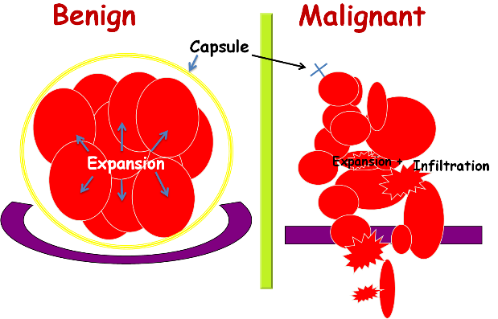
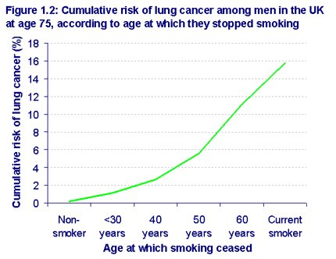
List different risk factors that affect disease:
Compare the formation of malignant and benign tumours.
Benign –
Malignant –
Risk 1: Smoking
Nicotine –
Carbon monoxide –
Smoking during pregnancy –
Carcinogens –
Smoking and the heart -
Risk 2: Diet, exercise and disease
Diet, exercise and obesity –
Exercise and health –
Obesity and type 2 diabetes -
Describe these, in terms of the graph below:
Casual mechanism
Correlation
Describe the treatments of cancer:
Radiotherapy:
Chemotherapy:
1. Label the different places pathogens can enter the body.
2. Describe the protective defences at each place.
Risk 3: Alcohol and Carcinogens
Alcohol and health –
Brain and liver damage –
Alcohol and pregnancy –
Ionising radiation -
What is a coronary artery and where would you find them?

Slide 6
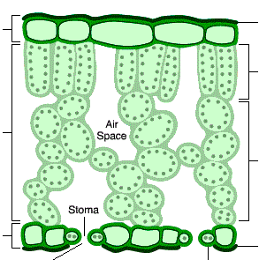
Describe aerobic respiration:
Summarise the reaction
Exo/Endothermic?
Where does it happen?
Describe anaerobic respiration:
Summarise the reaction
Why is lactic acid bad for us?
What is muscle fatigue?
How do we get rid of the lactic acid?
How does anaerobic respiration in yeast and plants differ from mammals?
(HIGHER) How does an oxygen debt form:
Label each part of the structure of a leaf:
Describe the role of each part and explain how it is adapted for photosynthesis.
Comparing Photosynthesis and Respiration
Name | Photosynthesis | Respiration
Word Equation
Symbol Equation
Reactants
Products
Who does it?
When do they do it?
Where does it happen?
Topic 4 Bioenergetics
Describe the limiting factors for photosynthesis.
Temperature –
Light intensity –
Concentration of CO₂ –
Describe the different ways plants use glucose:
Cellulose –
Starch –
Proteins and nitrates –
Lipids –
Glucose –
(HIGHER) Making photosynthesis more efficient:
Greenhouse –
Polytunnels –
Hydroponics -
Factor | Advantages | Disadvantages
Greenhouse
Polytunnels
Hydroponics
Describe the body’s response to exercise:
Muscles -
Glycogen -
Heart rate -
Breathing rate -
Describe the ways mammals use energy from respiration:
Building –
Muscles –
Temperature –
How are mitochondria adapted for respiration:
1.
2.
Discuss metabolism and the liver in:
It’s role –
Removing lactic acid –
List metabolic reaction examples –

