Slide 1
Write down a definition of the following properties -
Strength
Toughness
Hardness
Malleability
State a material exhibits each property.

Slide 2
The timber industry is a major factor in global sustainability.
Planets main carbon absorber / oxygen producer.
Is a major raw material for products and construction.

Slide 3
Deforestation is a major concern. Managed forests are part of the solution.

Slide 4
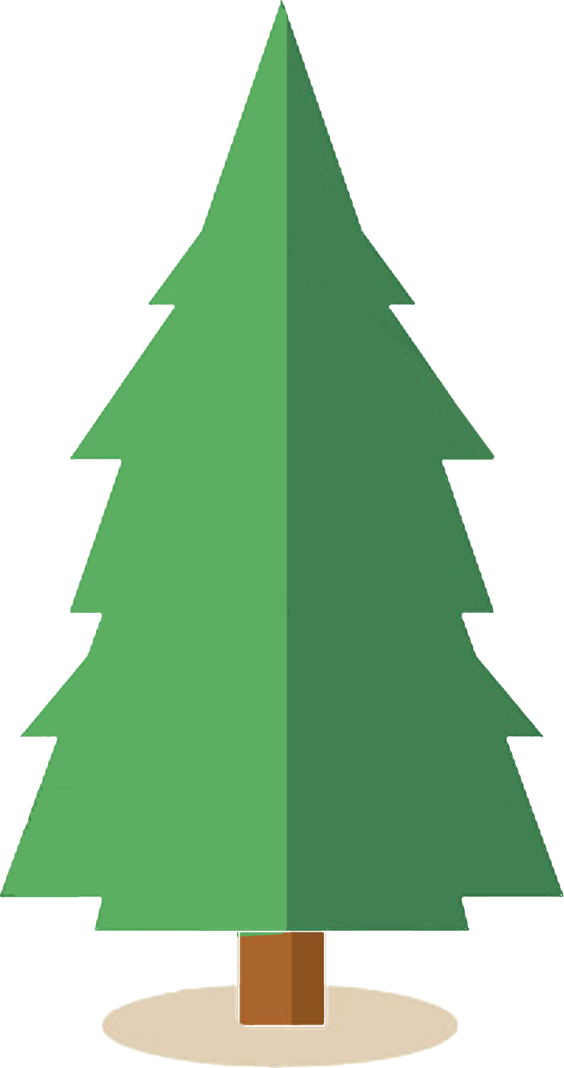
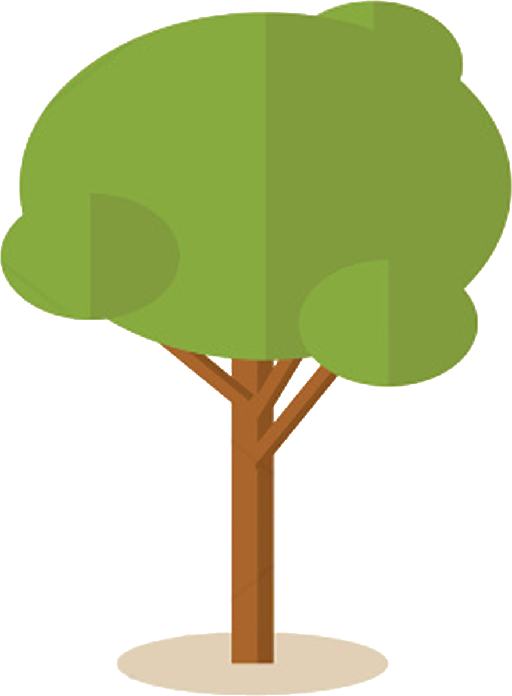
Softwoods and Hardwoods
Coniferous Deciduous
(Evergreen) (loose leaves)
20-30yrs 100-500yrs
Relatively cheap Expensive
Rots easily Durable
Weaker Stronger
Soft Harder
Less tough More tough

Slide 5
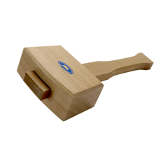
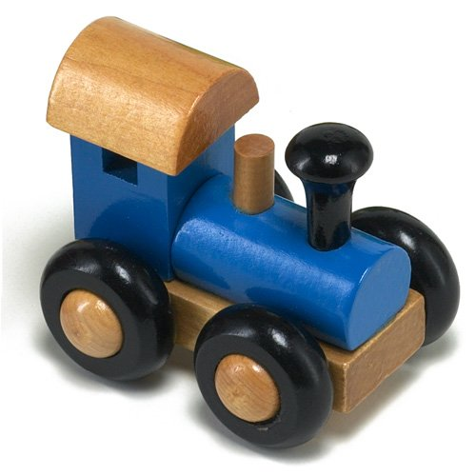
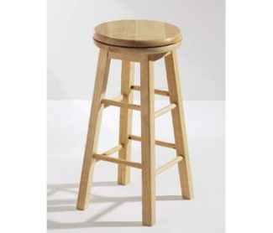
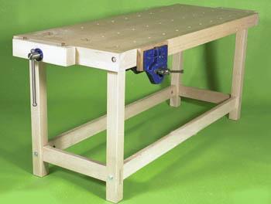
Beech
“Beech”
Tough

Slide 6
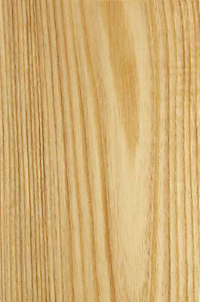
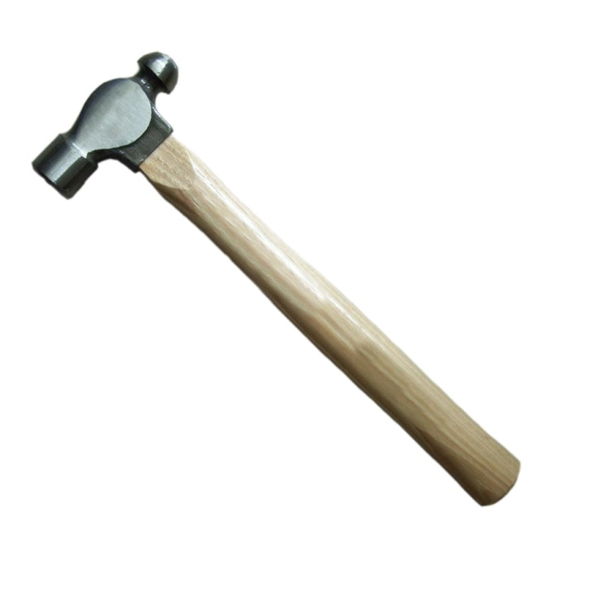
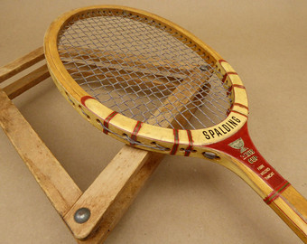
“Ash”
Flexible

Slide 7
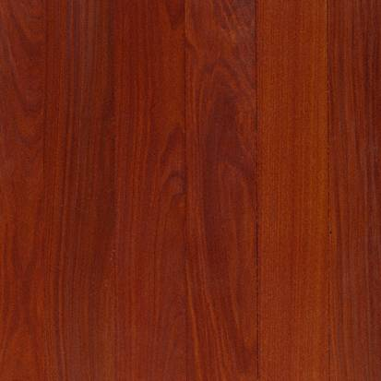
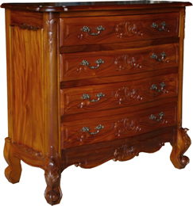
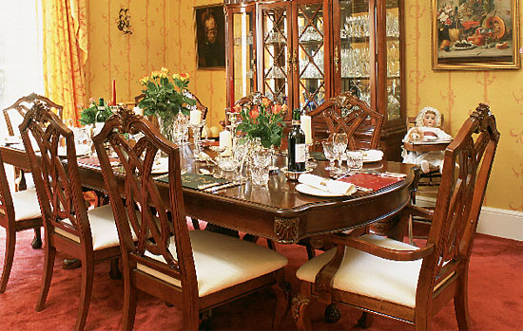
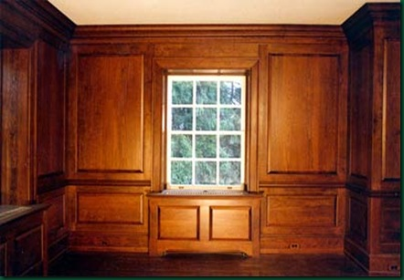
“Mahogany”
Dark, good aesthetics

Slide 8
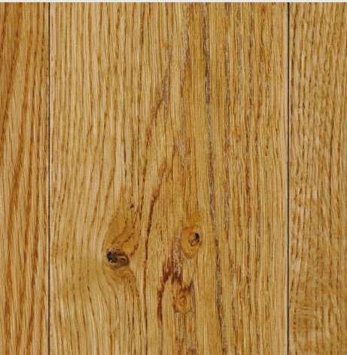
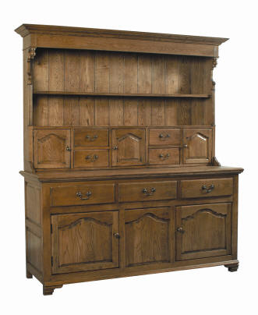
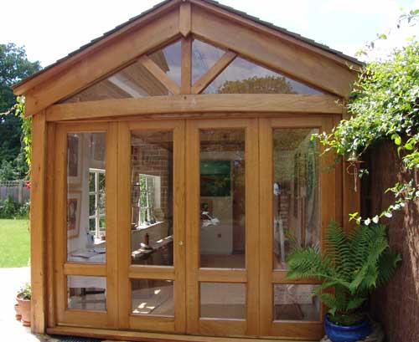
“Oak”
Good all rounder

Slide 9
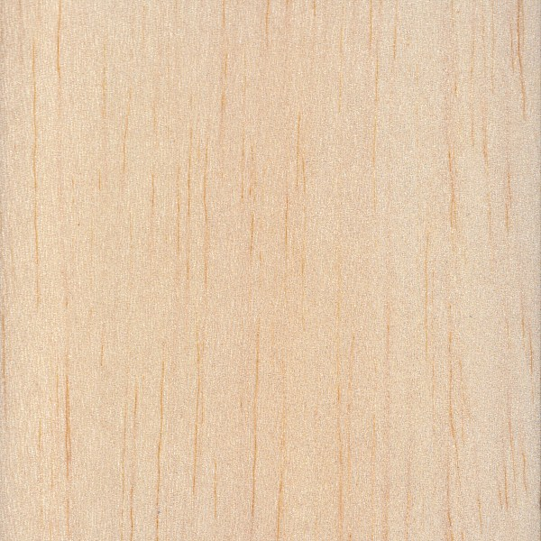
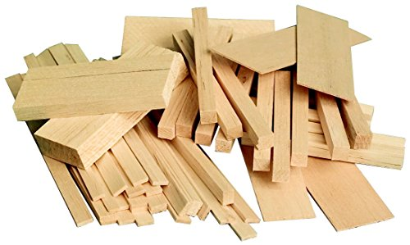
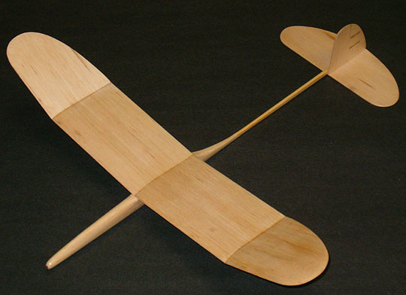
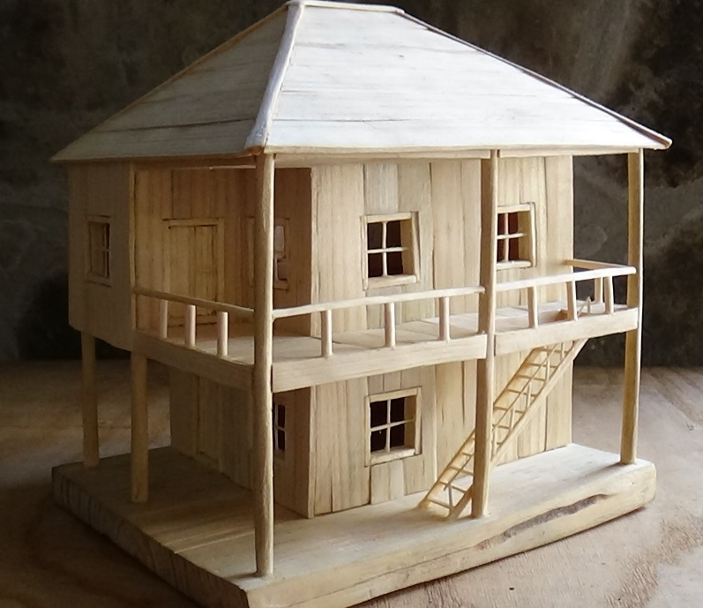
“Balsa”
Soft, easily cut and
lightweight

Slide 10
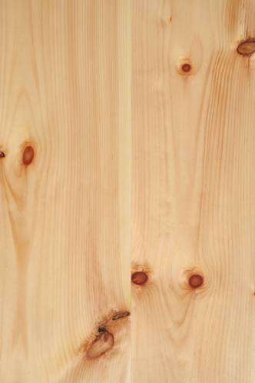
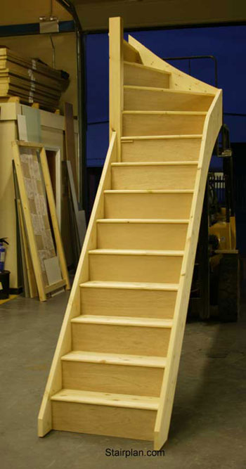
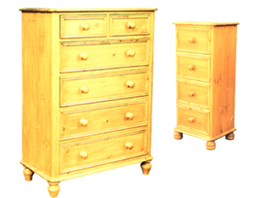
“Pine”
Cheaper

Slide 11
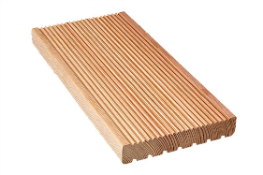
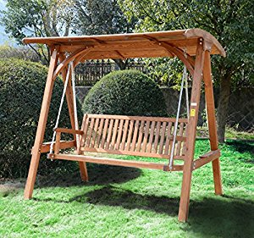
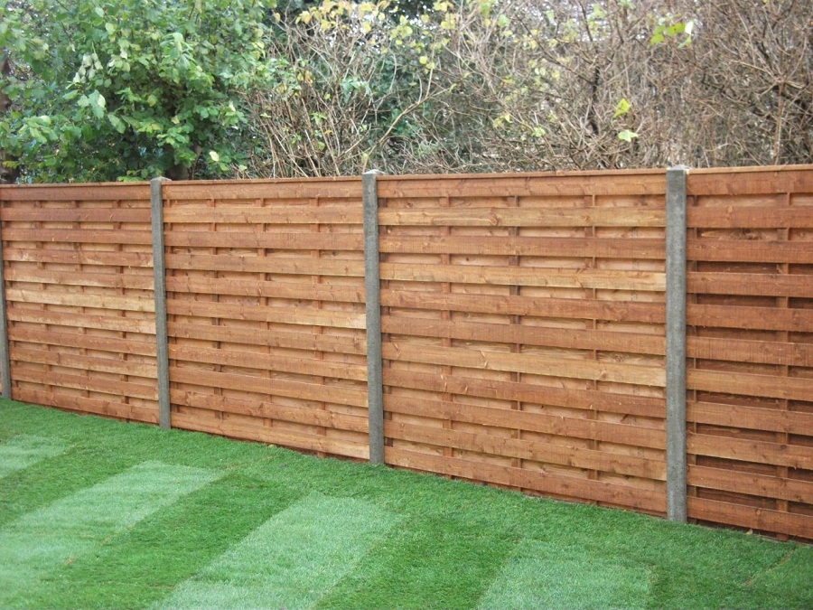
“Larch”
Quite durable

Slide 12
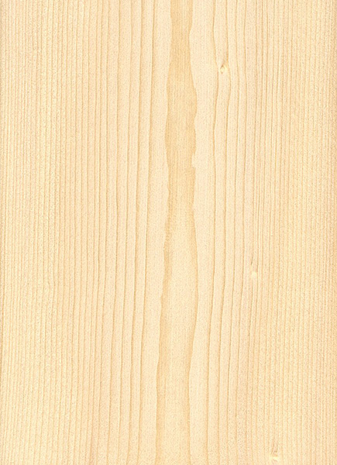
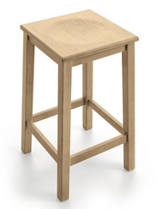
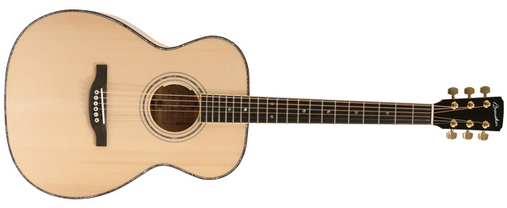
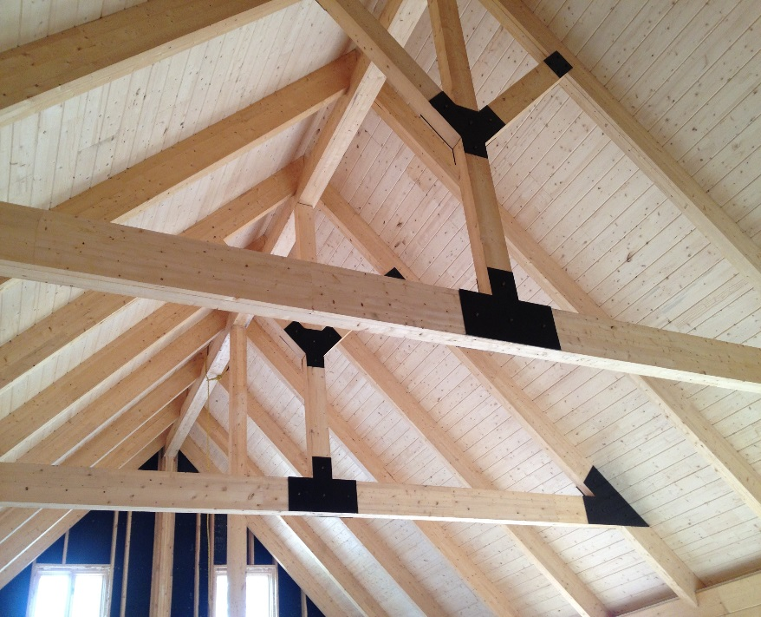
“Spruce”
Lightweight and quite strong

Slide 13
Which wood?

Slide 14
I NOW KNOW:
The differences between the 2 timber groups.
How to identify the key properties and uses of different types of timber.

